Slide 1
How to Submit a
New Biological Use
Authorization (BUA)

Slide 2
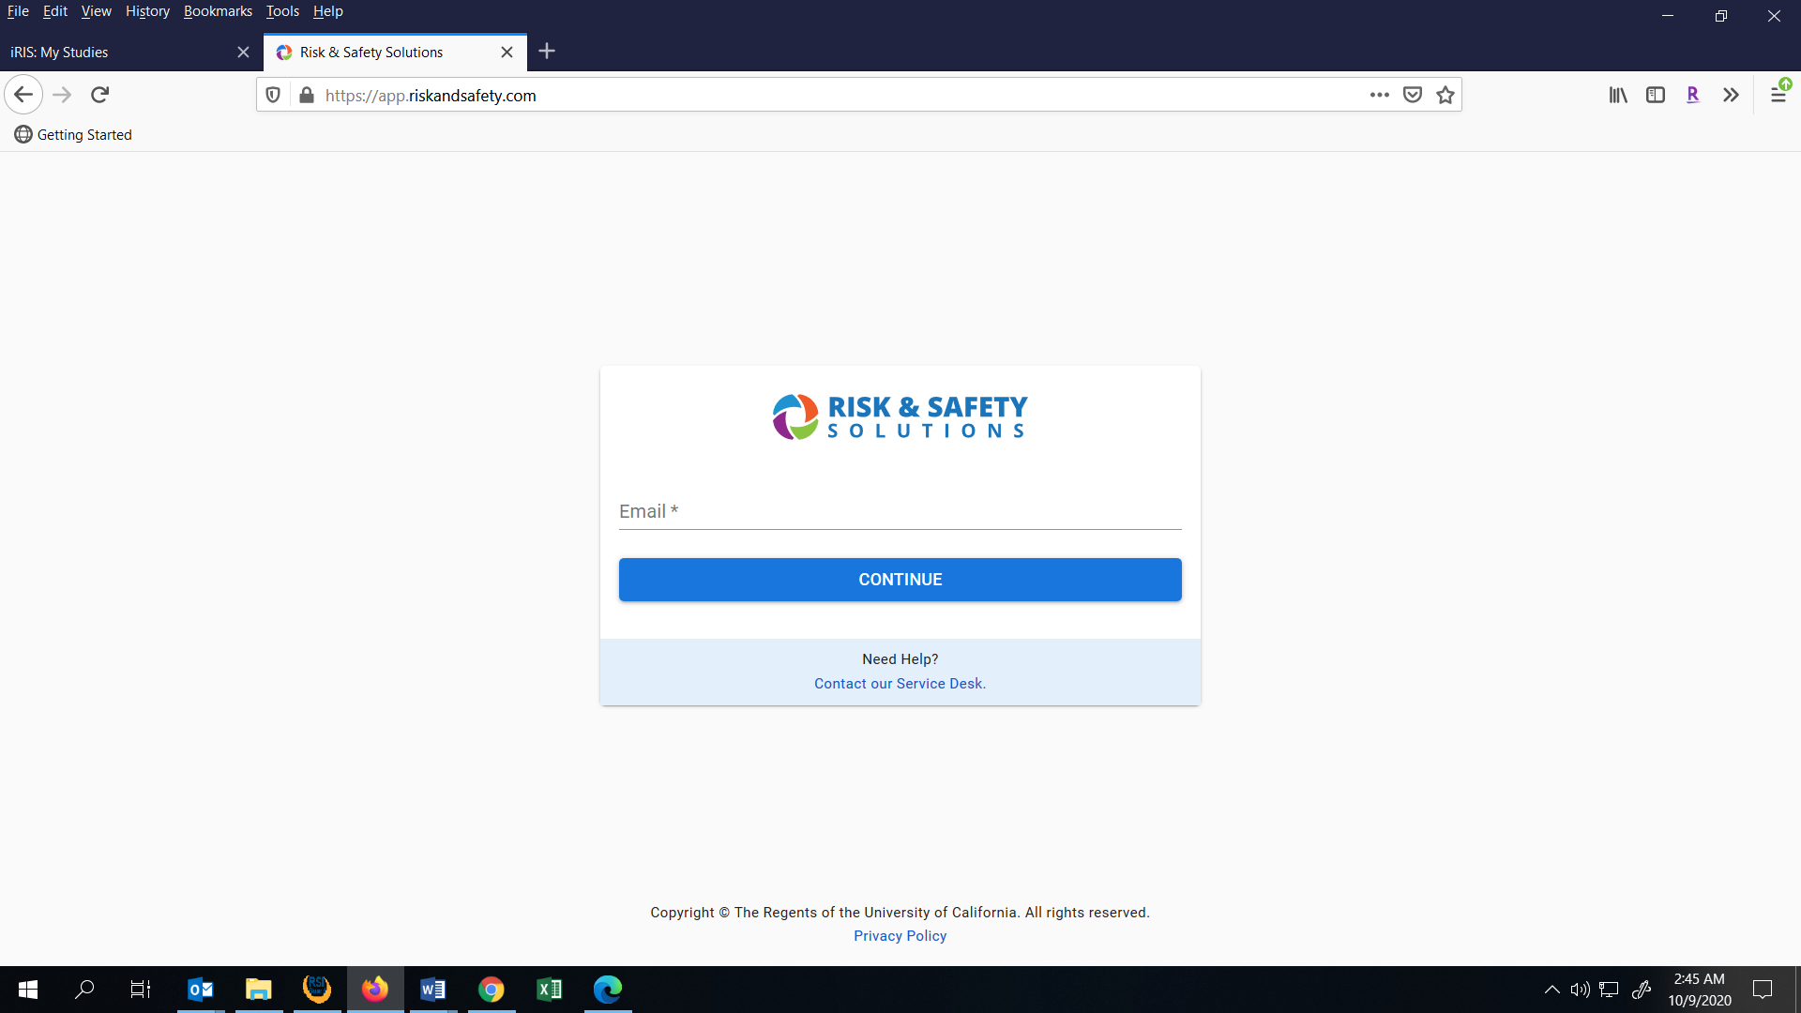
Log into RSS-BIO at: https://app.riskandsafety.com

Slide 3
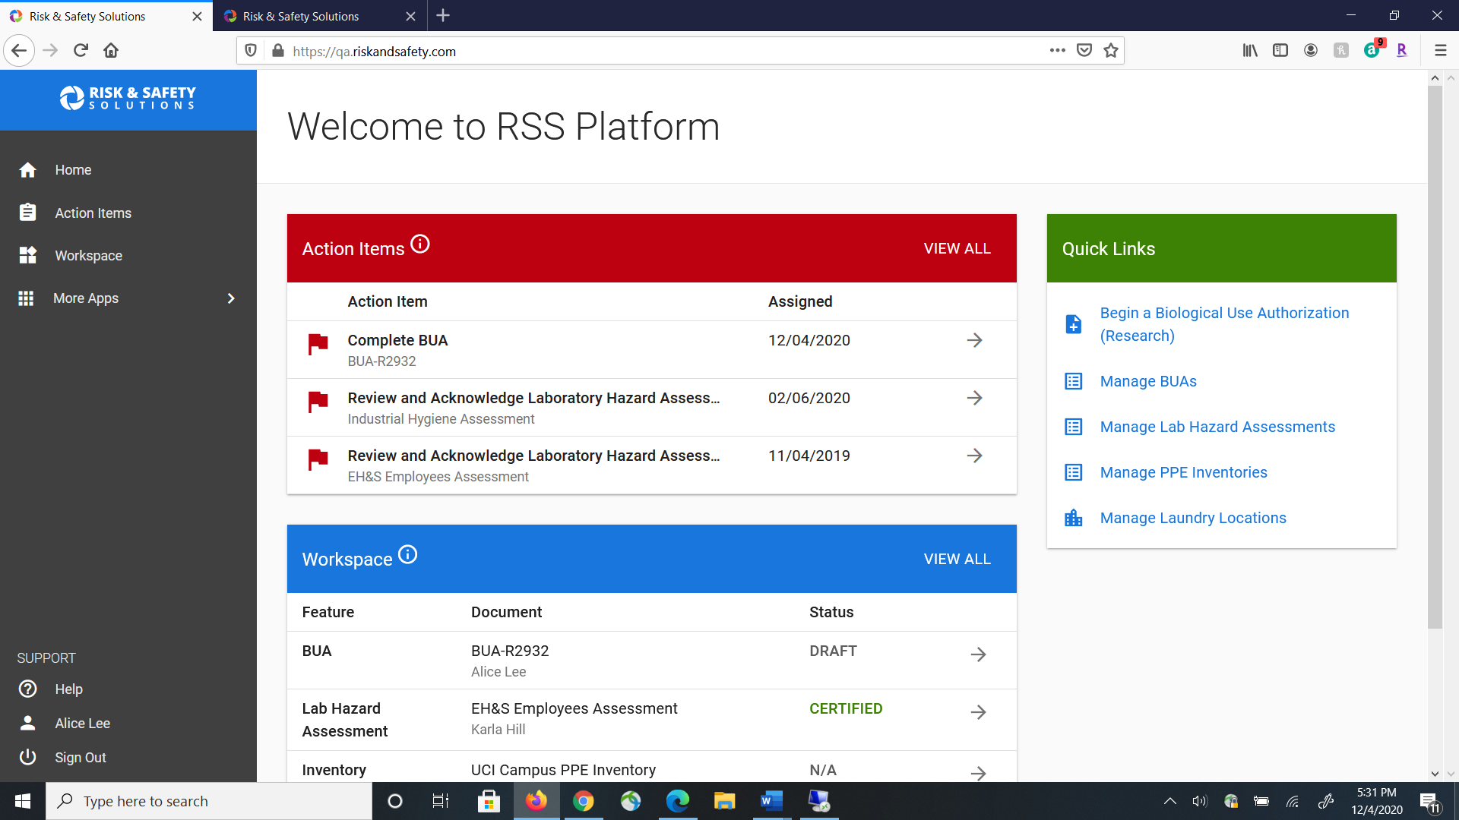


Use Quick Links to select “Begin a Biological Use Authorization (Research)”.

Slide 4
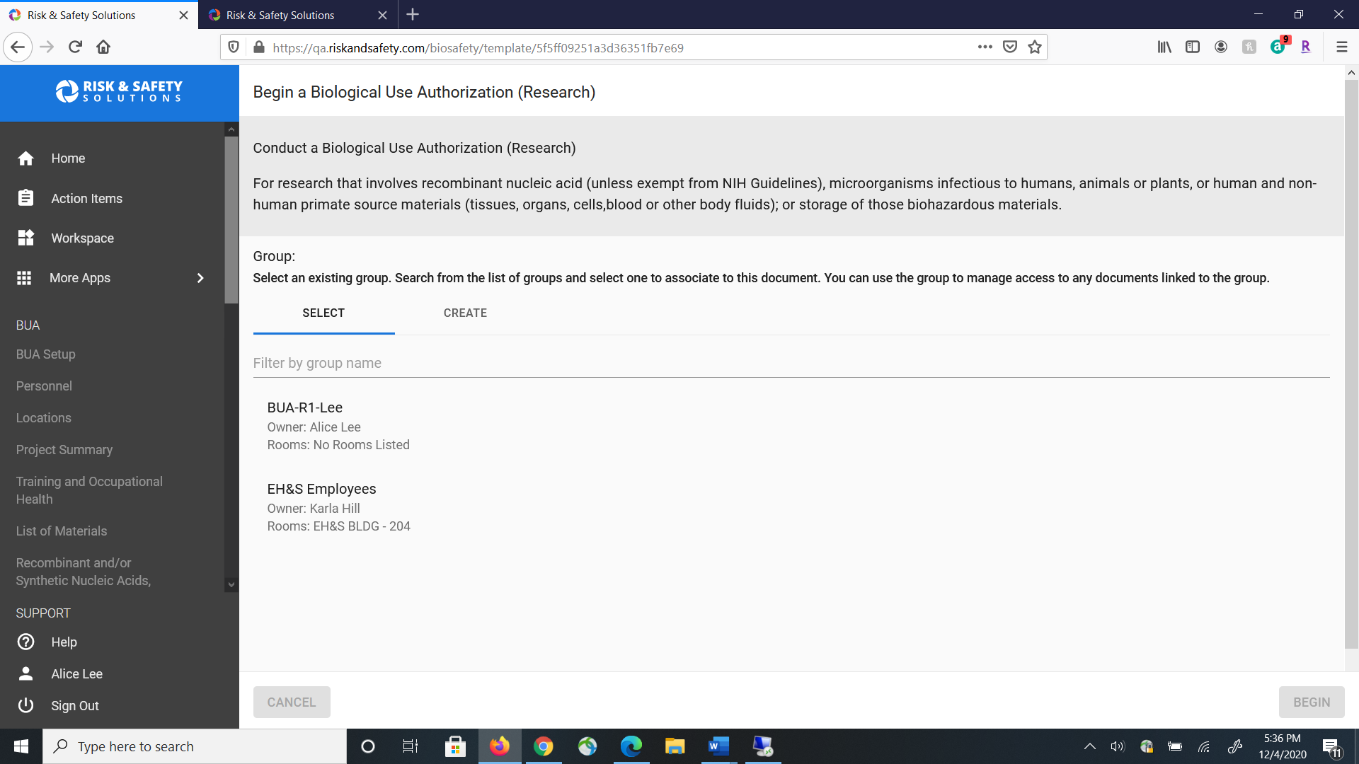
Use Select to add an existing group in the system or use Create to start a new group.

Slide 5
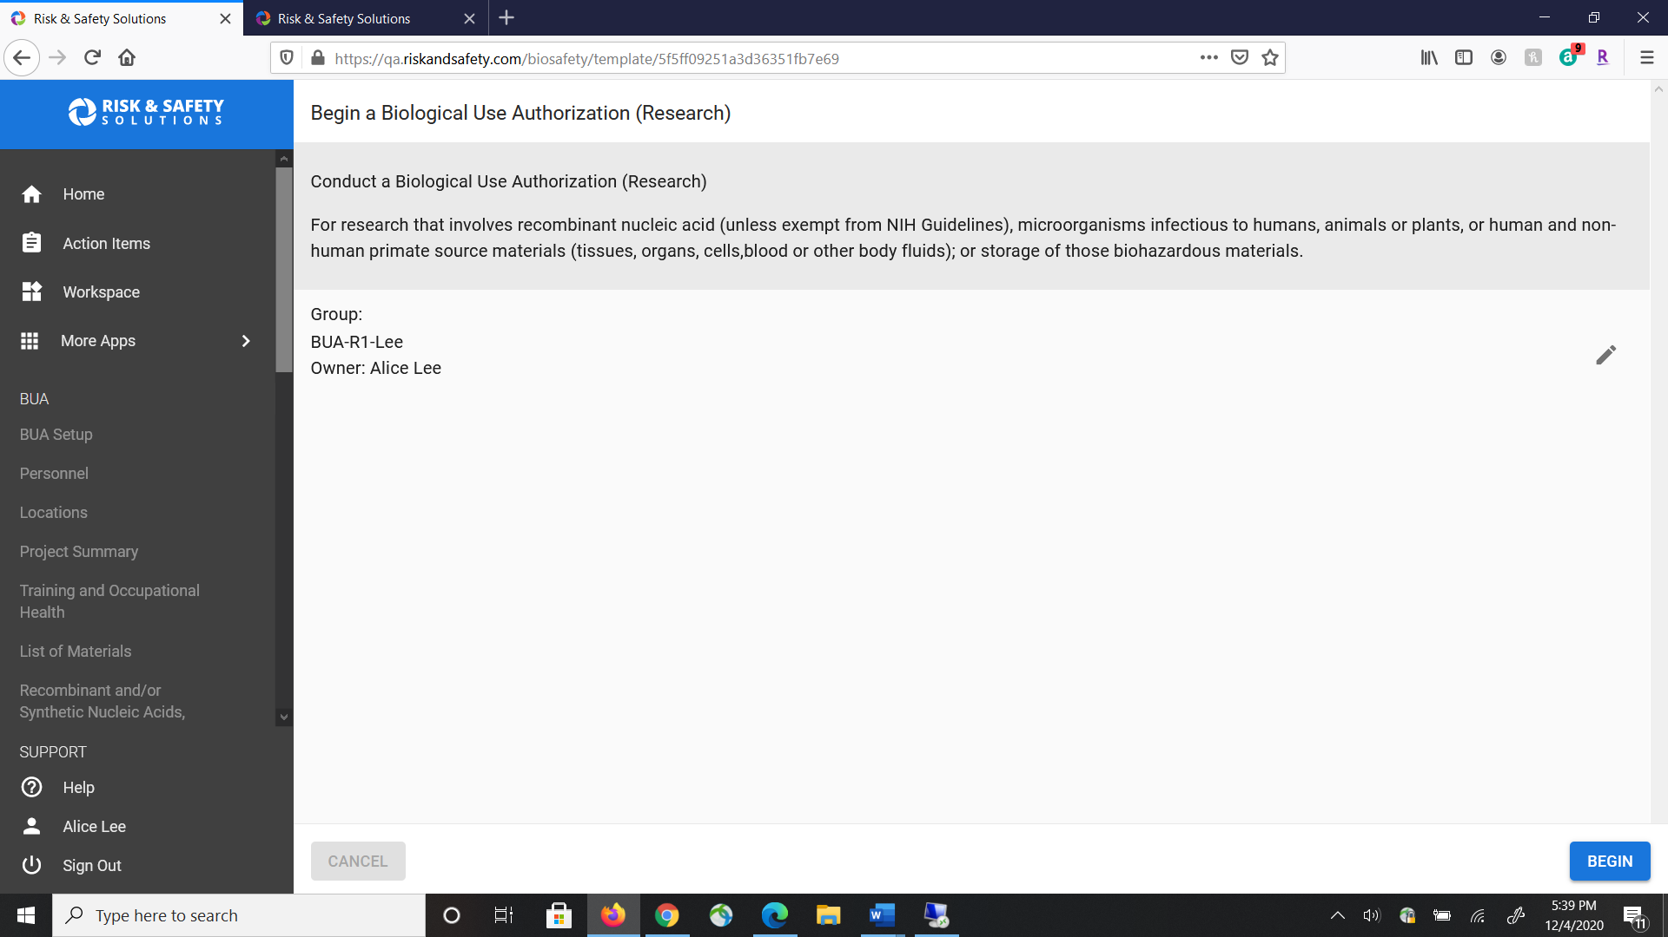

Click Begin to begin a new Biological Use Authorization (BUA).

Slide 6
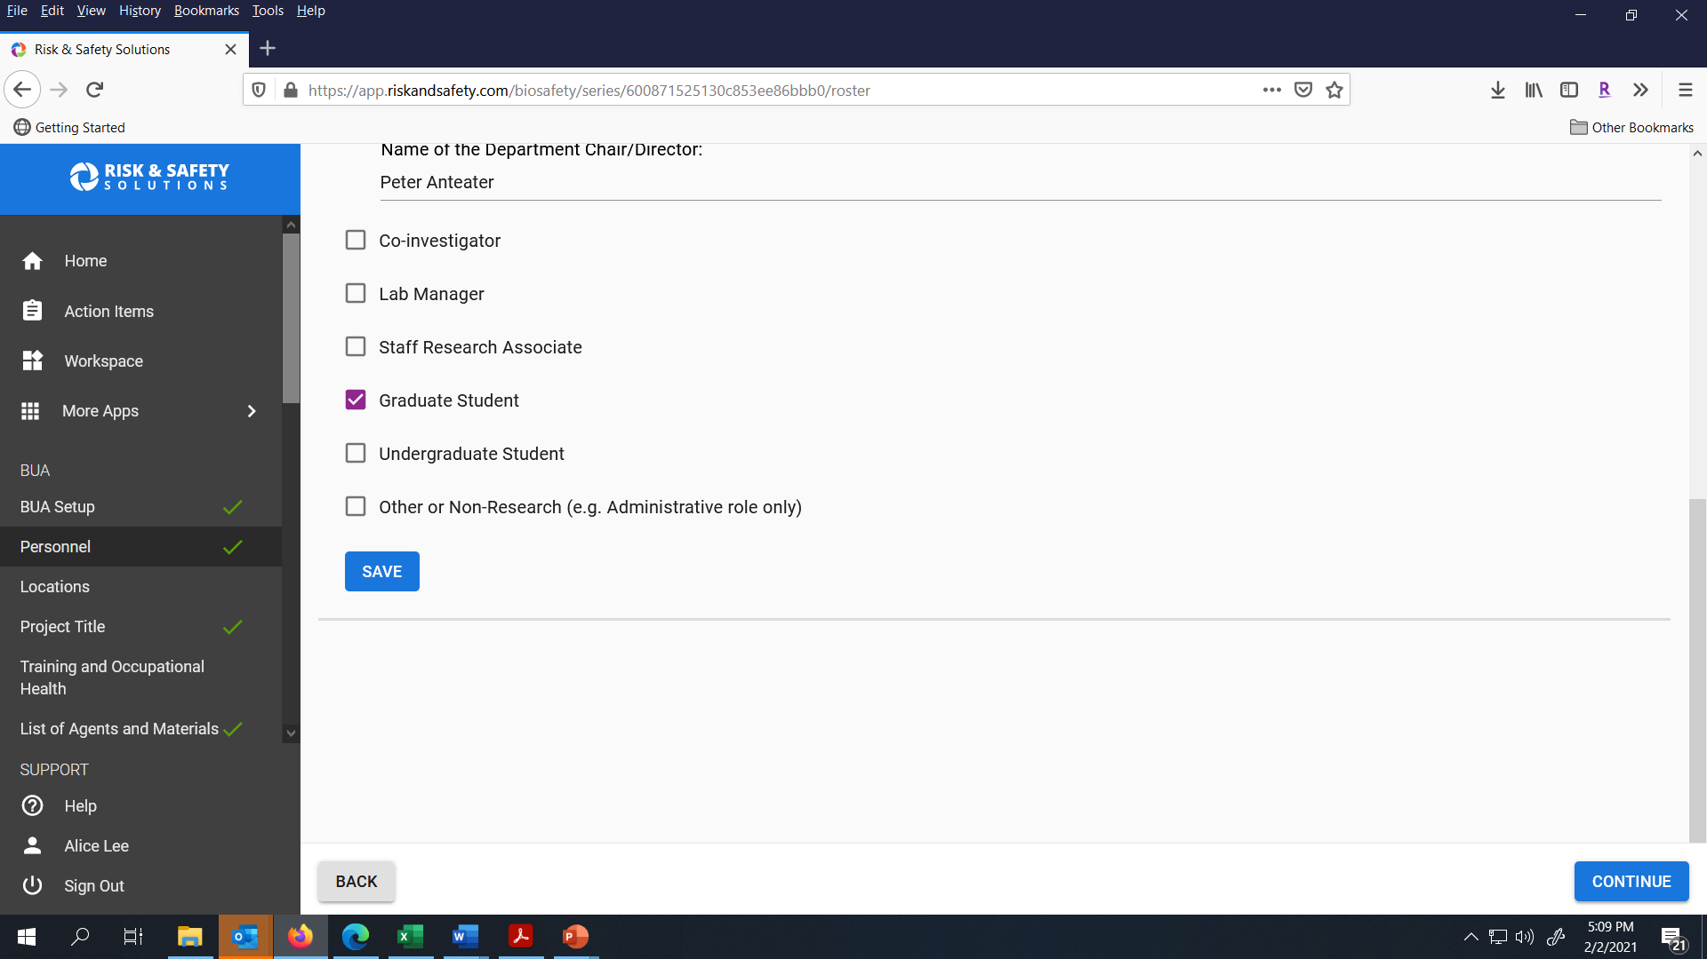
Type in the person’s last name to search for them and click Save to add the person. Click Continue when you are ready to go to the next section.

Slide 7
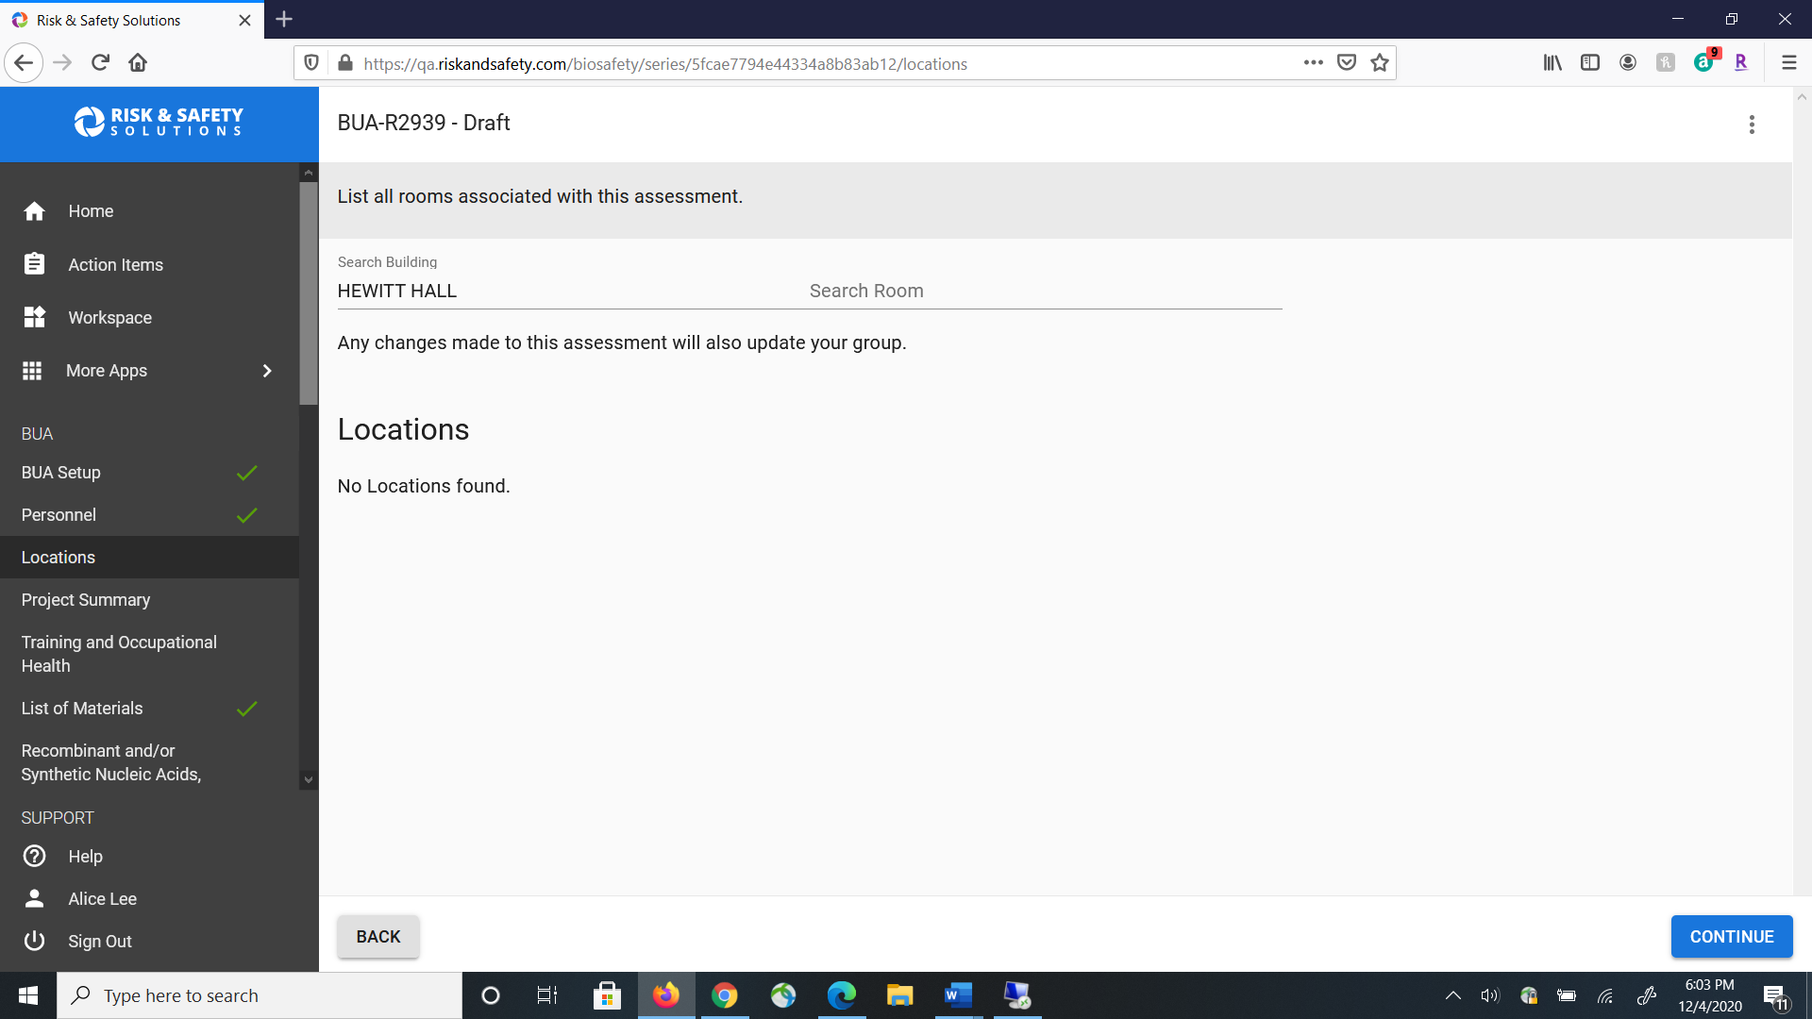
For the Locations section, enter the building name under Search Building and then the Room number in the Search Room field to pull up the location. If the system cannot bring up your building name or room number, please contact ibc@uci.edu.

Slide 8
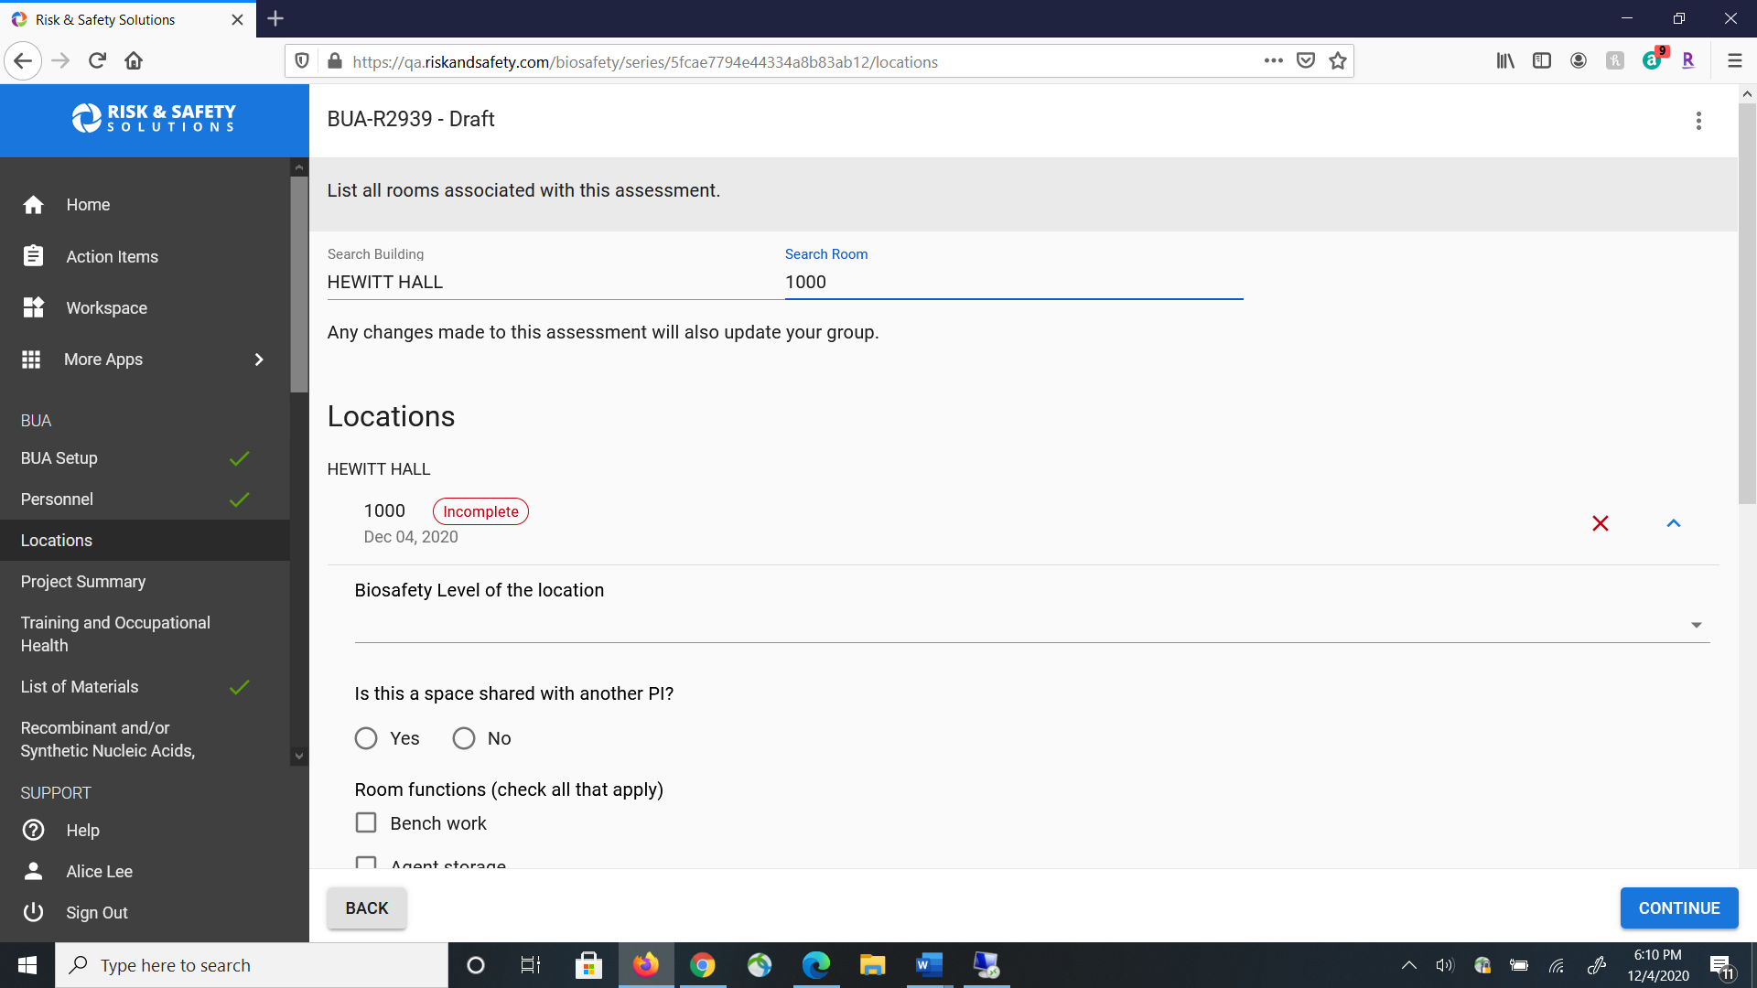
Provide the requested information for the
Study Location.

Slide 9
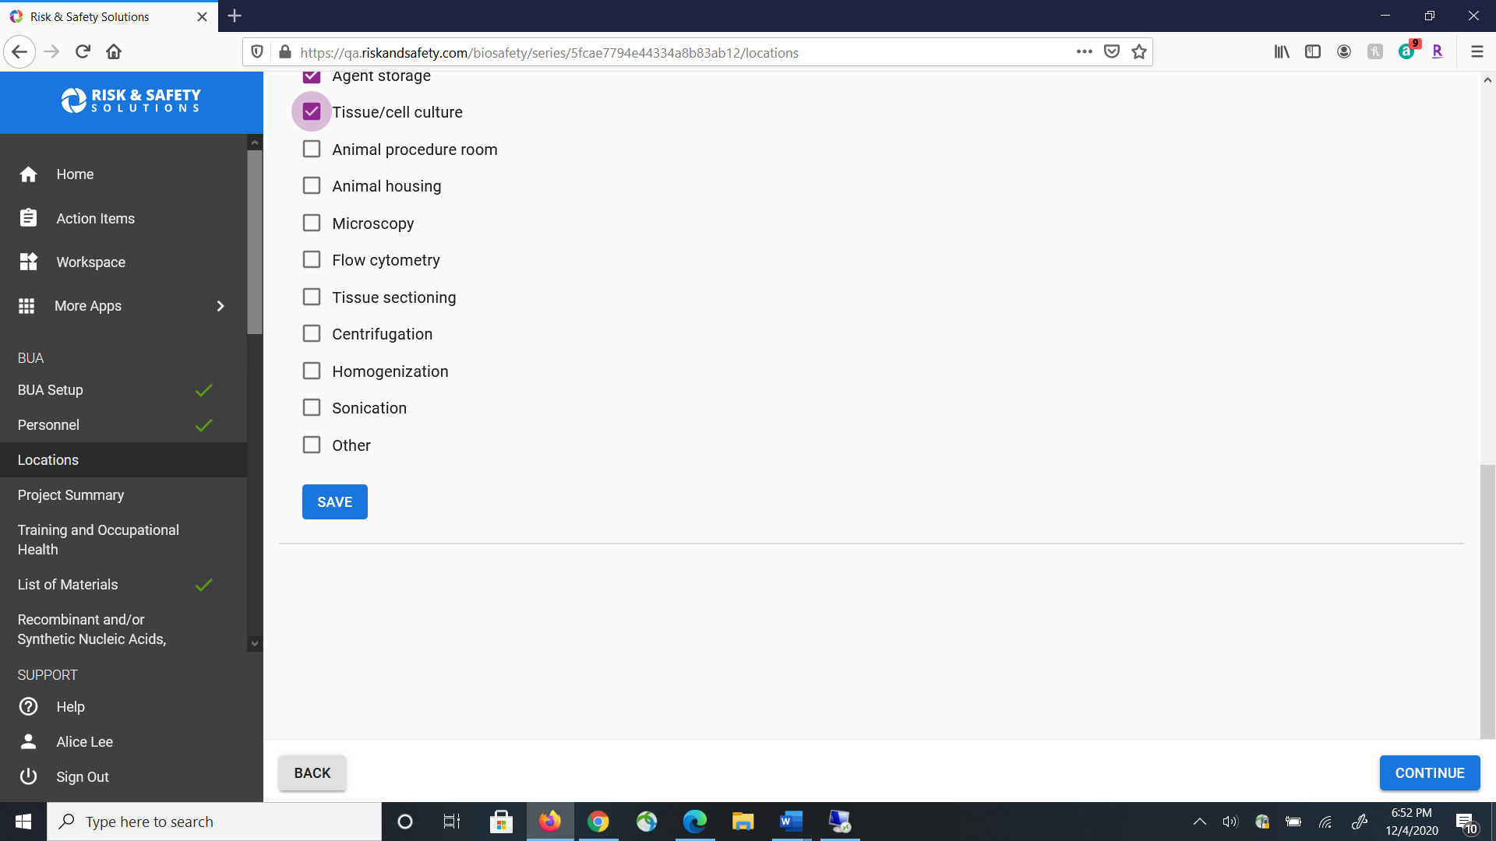
Click Save to add this study location to your BUA.

Slide 10

Click Continue to go to the next section.

Slide 11
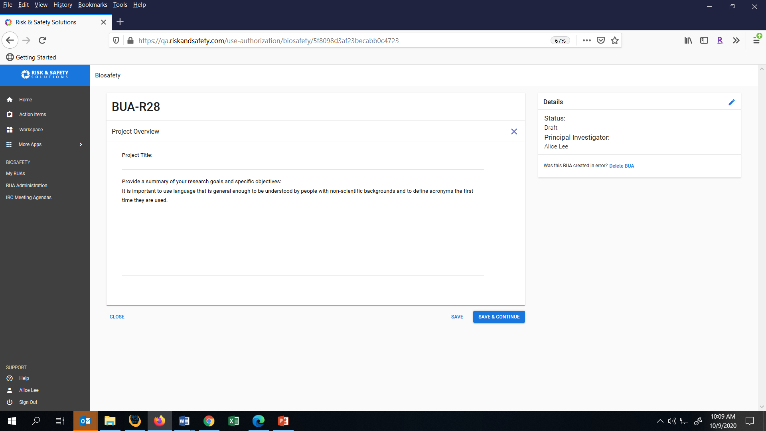
Project Overview: Provide the Project Title and a summary of your research goals and specific objectives. Click Save and Continue to move to the next section.

Slide 12
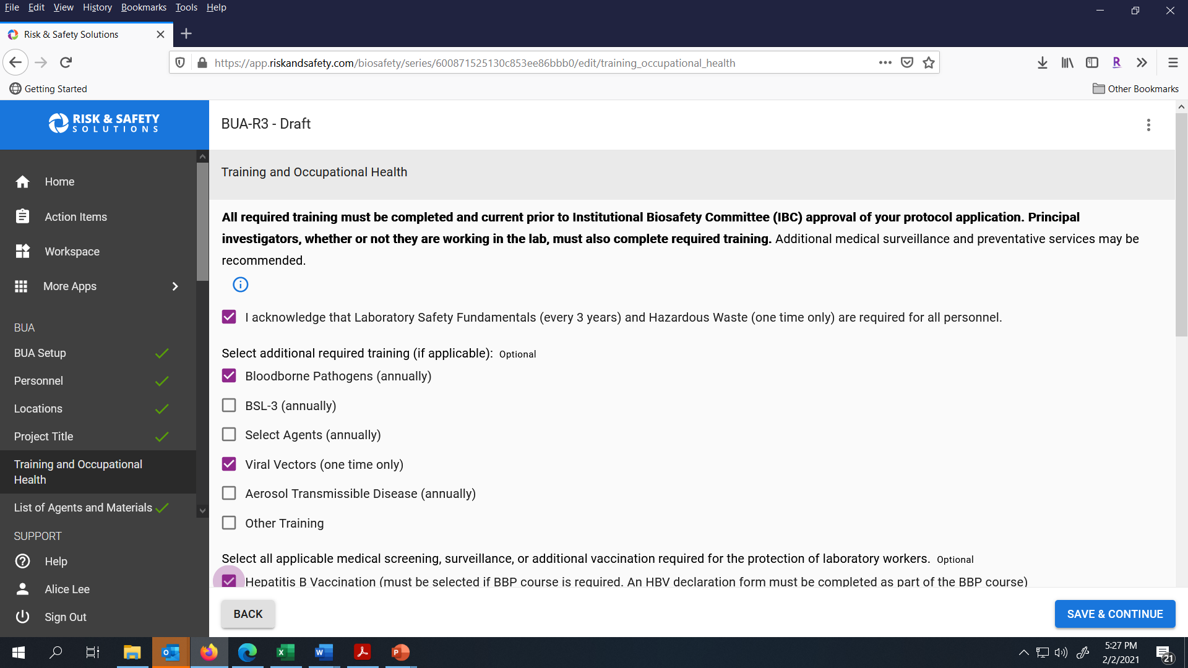
Provide the Training and Occupational Health information for your BUA and then click Save & Continue to go to the next section.

Slide 13
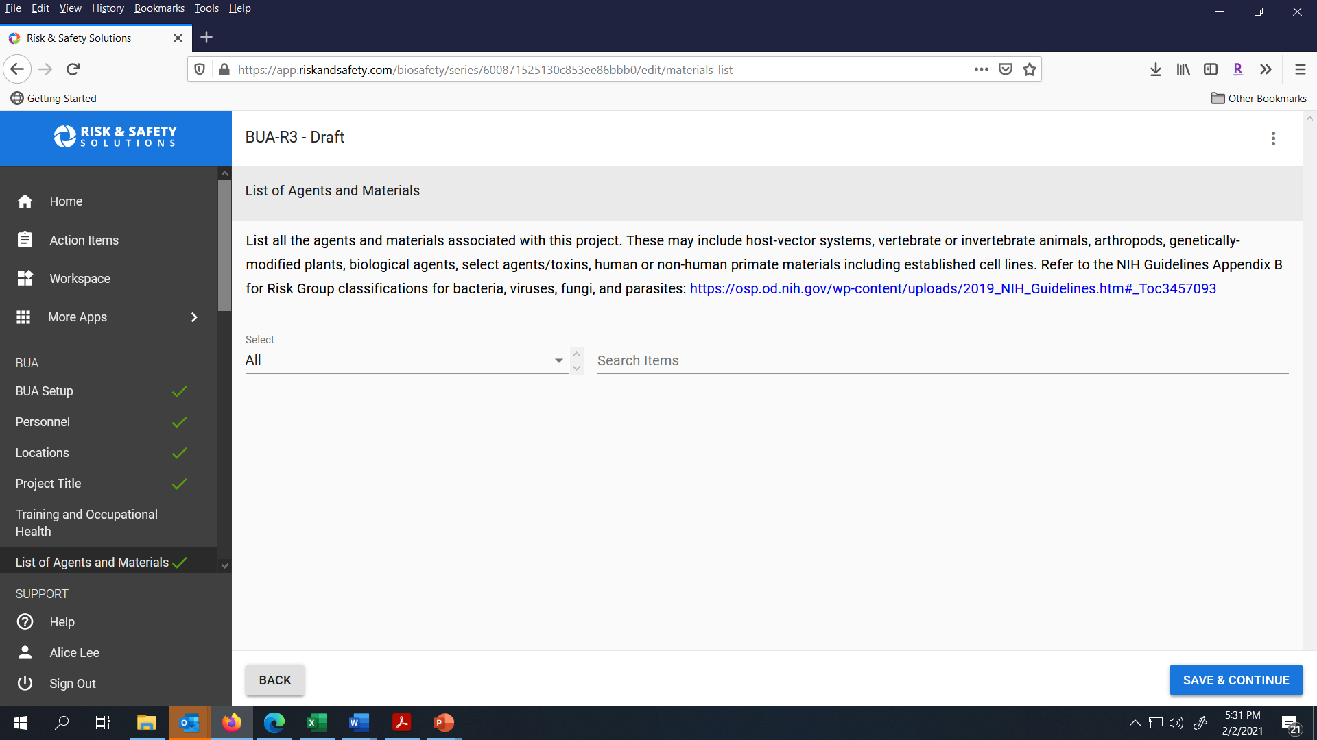
Type in the agent or material name in the Search Items field.

Slide 14
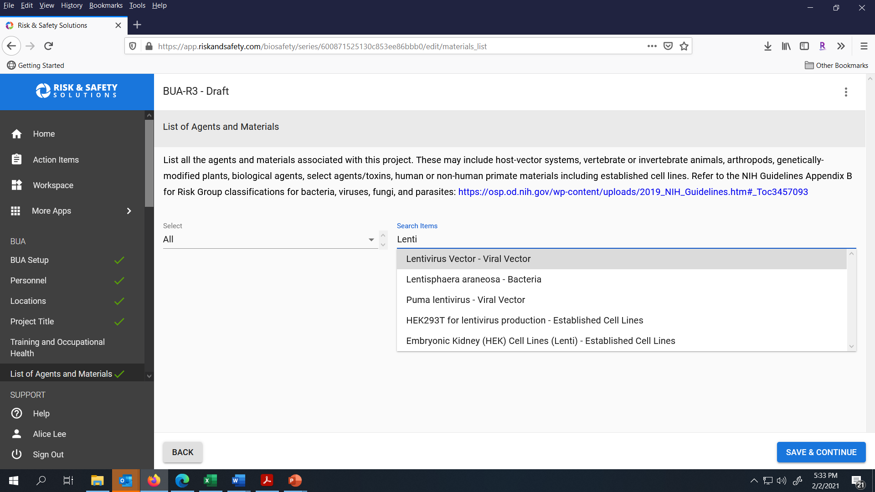
Click on the correct name in the dropdown menu.

Slide 15
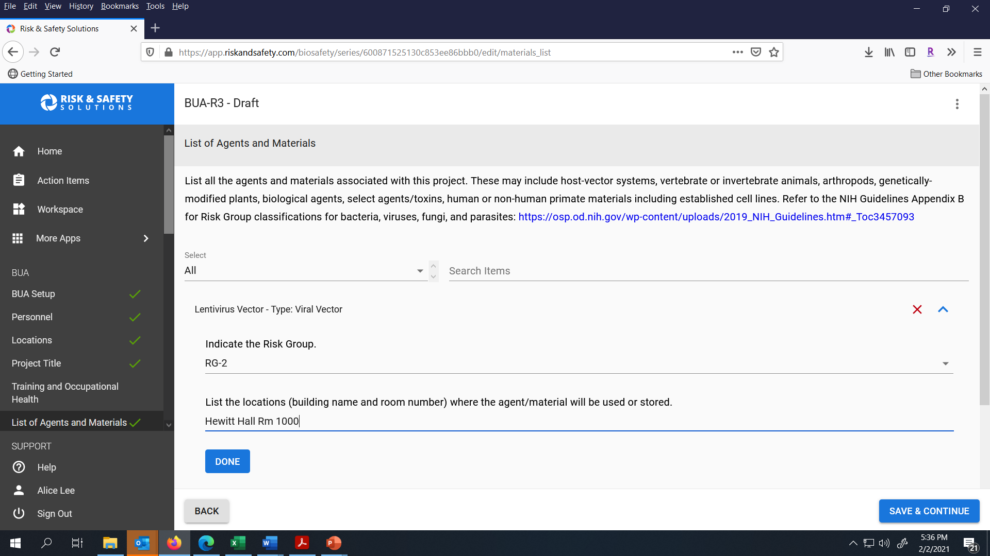
Provide the Risk Group and locations of the agent. Click Done and repeat process again to add all your agents and materials.

Slide 16

Click Save & Continue to move to the next section.

Slide 17
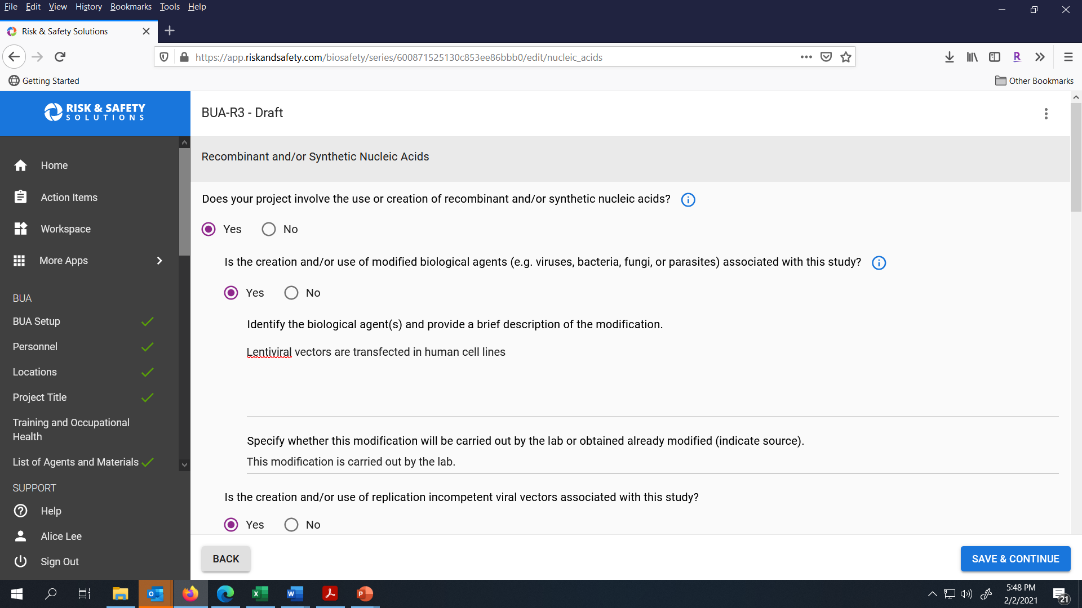
Complete this section for the Use of Recombinant and/or Synthetic Nucleic Acids and then click Save & Continue.

Slide 18
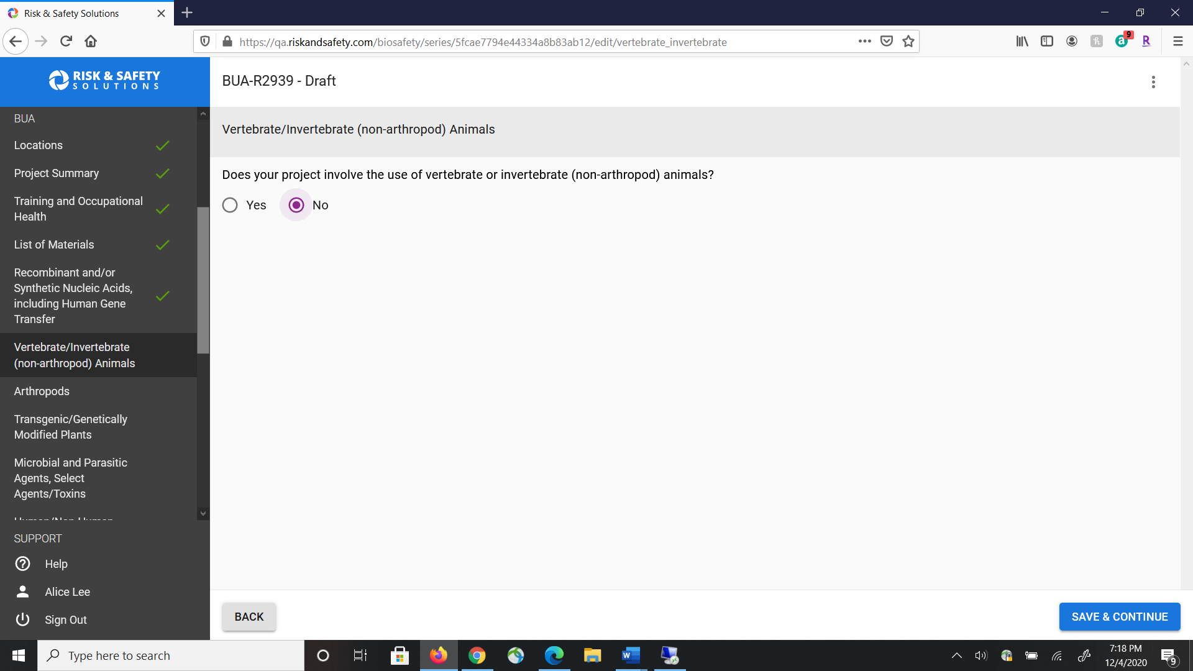
Click No if your project does not involve the use of vertebrate or invertebrate animals. Click Save & Continue to go to the next section.

Slide 19
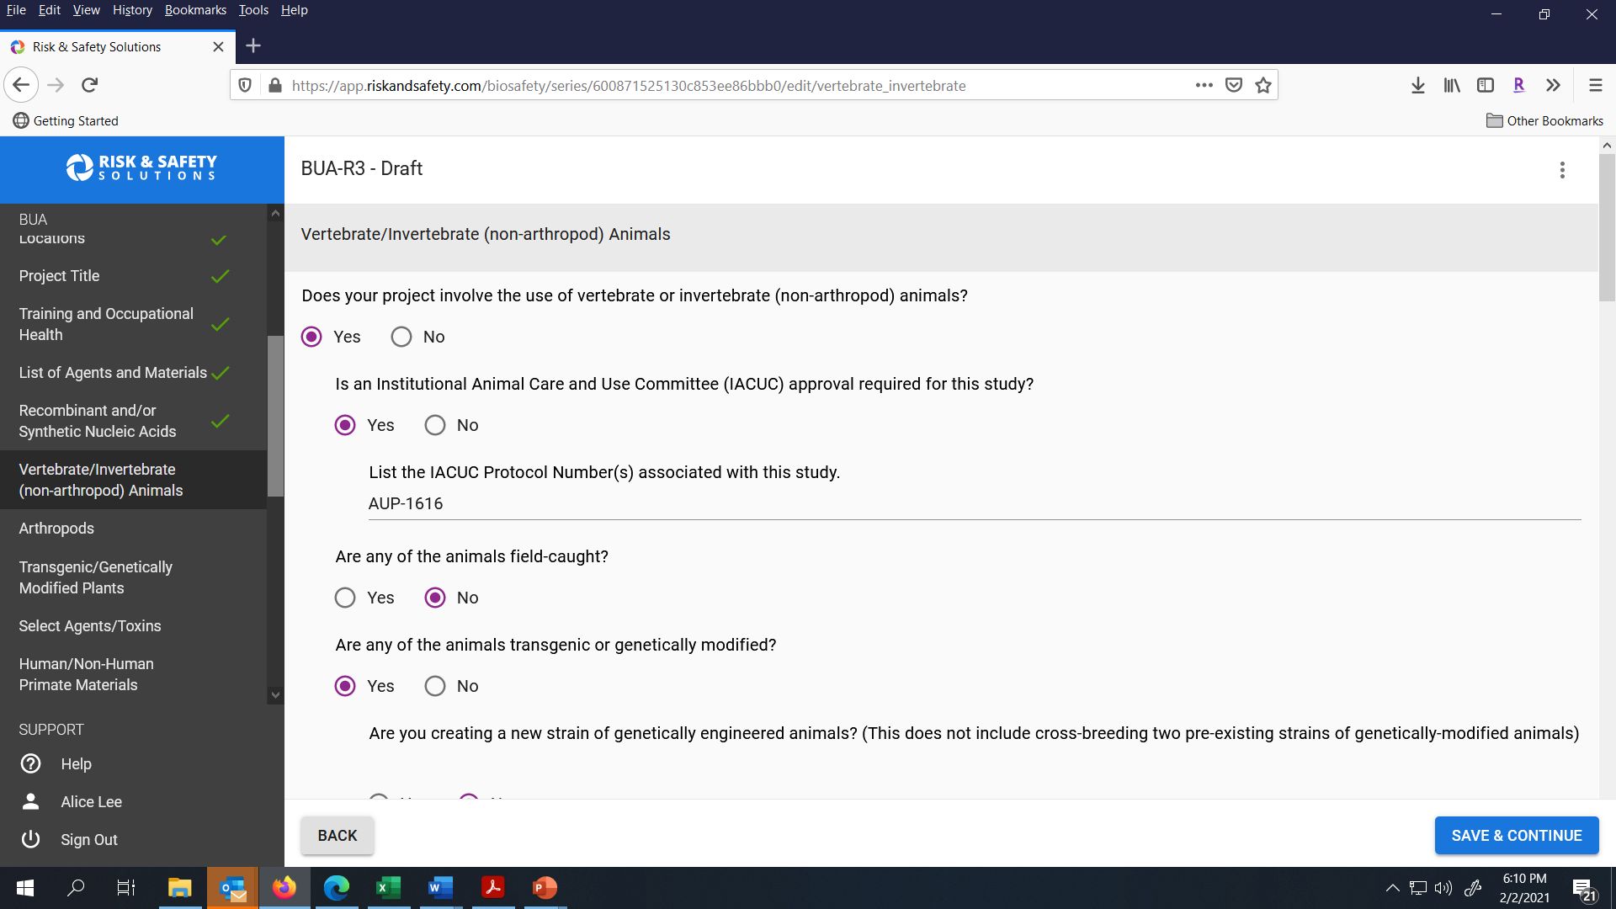
If your BUA does have animal work, check Yes and answer the questions that appear. Click Save & Continue to go to the next Section.

Slide 20
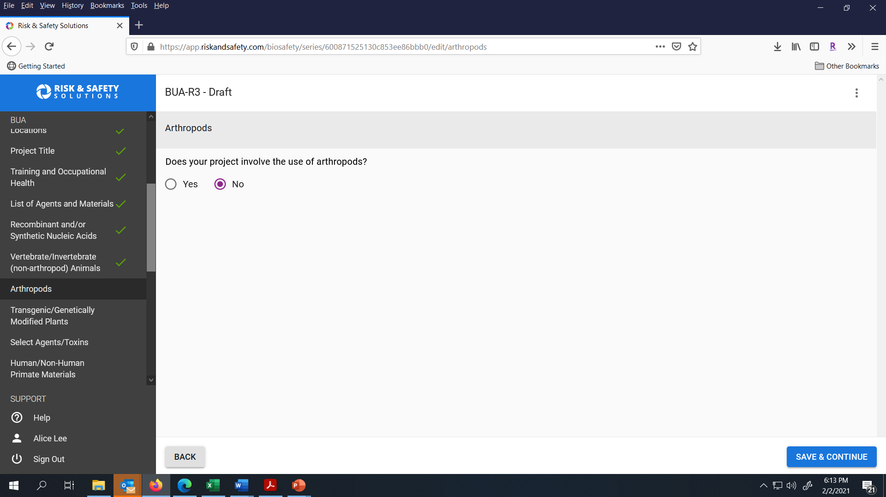
Check No if your study does not use arthropods and click Save & Continue to go to the next section.

Slide 21
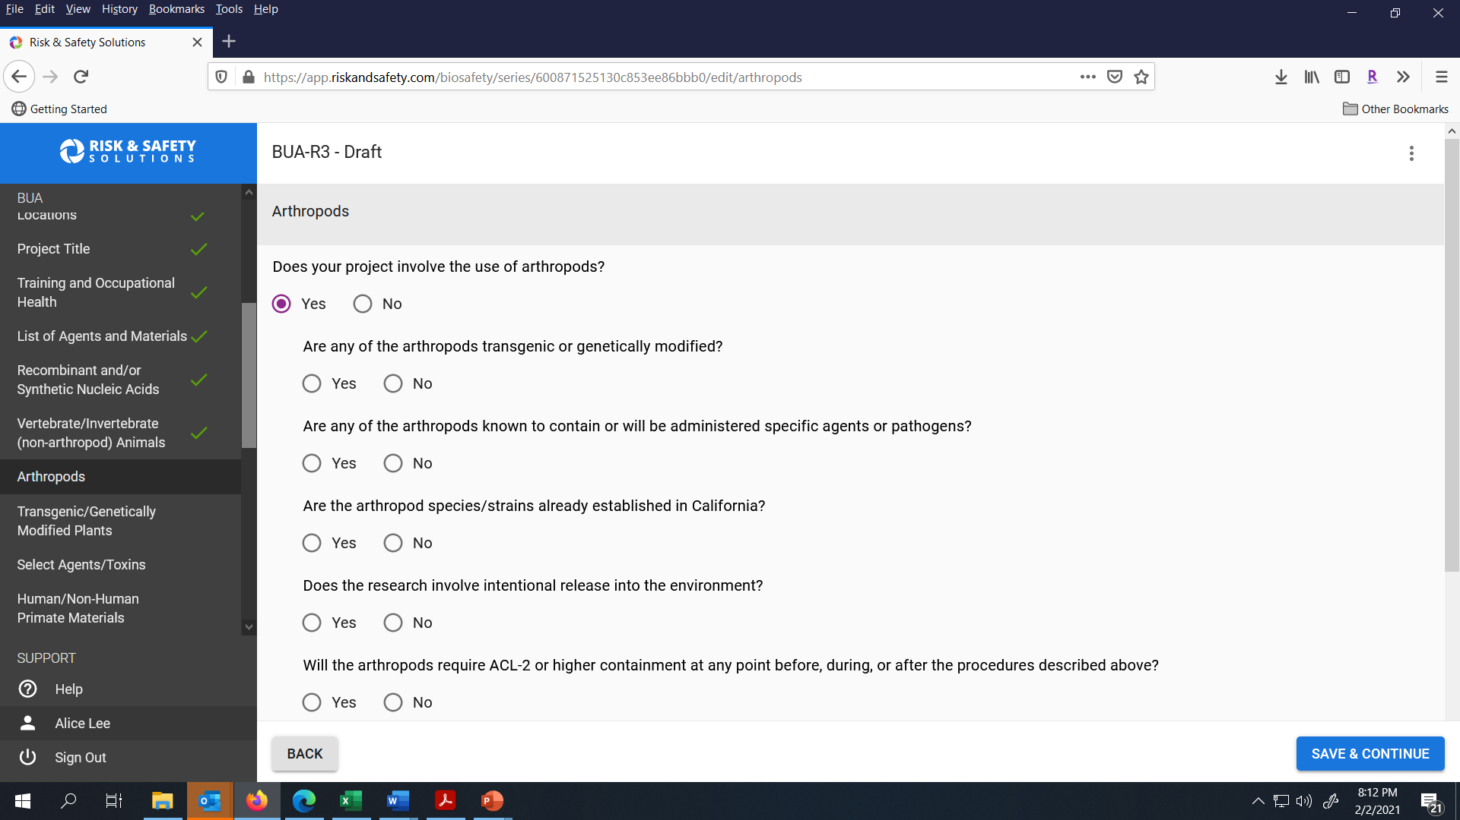
Check Yes if your study uses arthropods and complete the questions that appear. Click Save & Continue to go to the next section.

Slide 22

Check No if your study does not work with plants. Check Save & Continue to go to the next section.

Slide 23
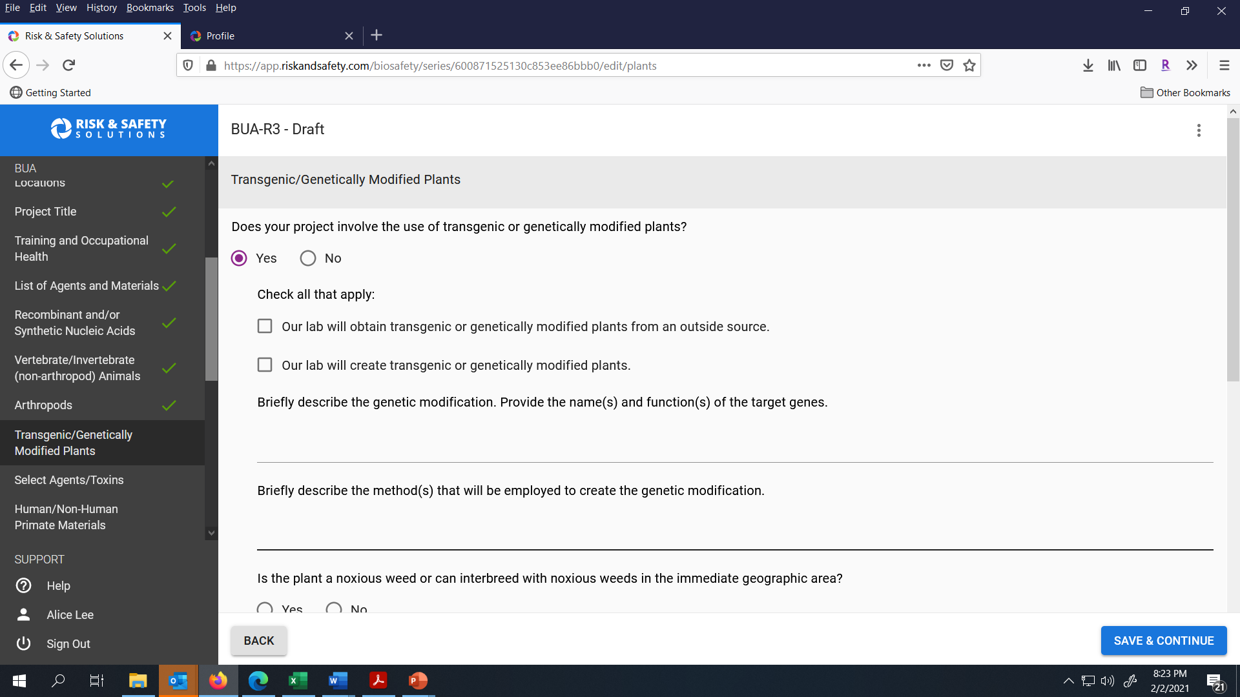
Check Yes if your study uses transgenic plants and complete the questions that appear. Click Save & Continue to go to the next section.

Slide 24
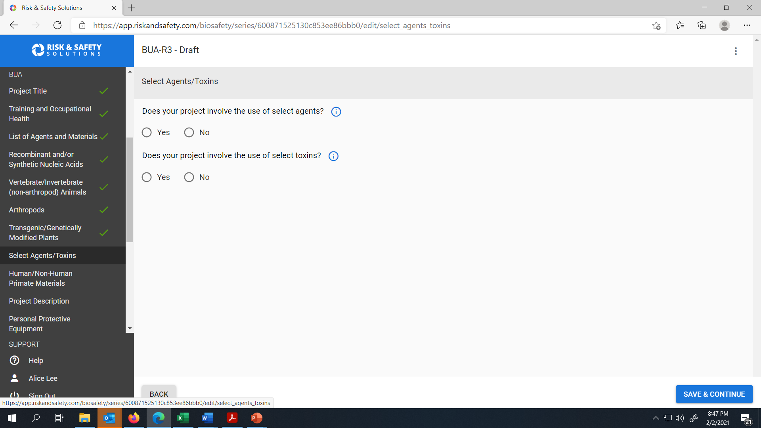
Check Yes if your study uses Select Agents/ Toxins and complete the questions that appear. Click Save & Continue to go to the next section.

Slide 25
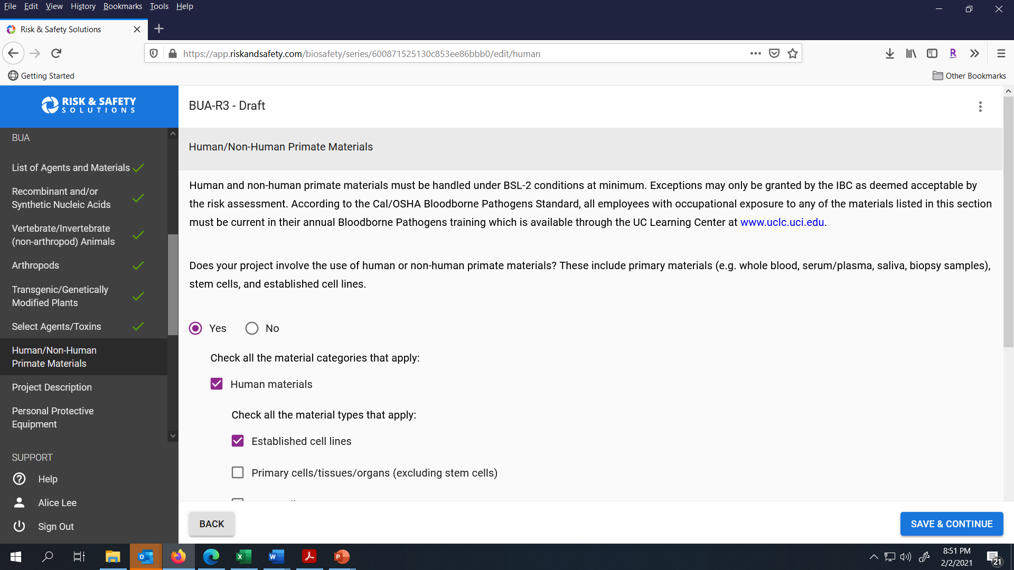
Check Yes if your study uses Human/ Non-Human Primate materials and complete the questions that appear. Click Save & Continue to go to the next section.

Slide 26
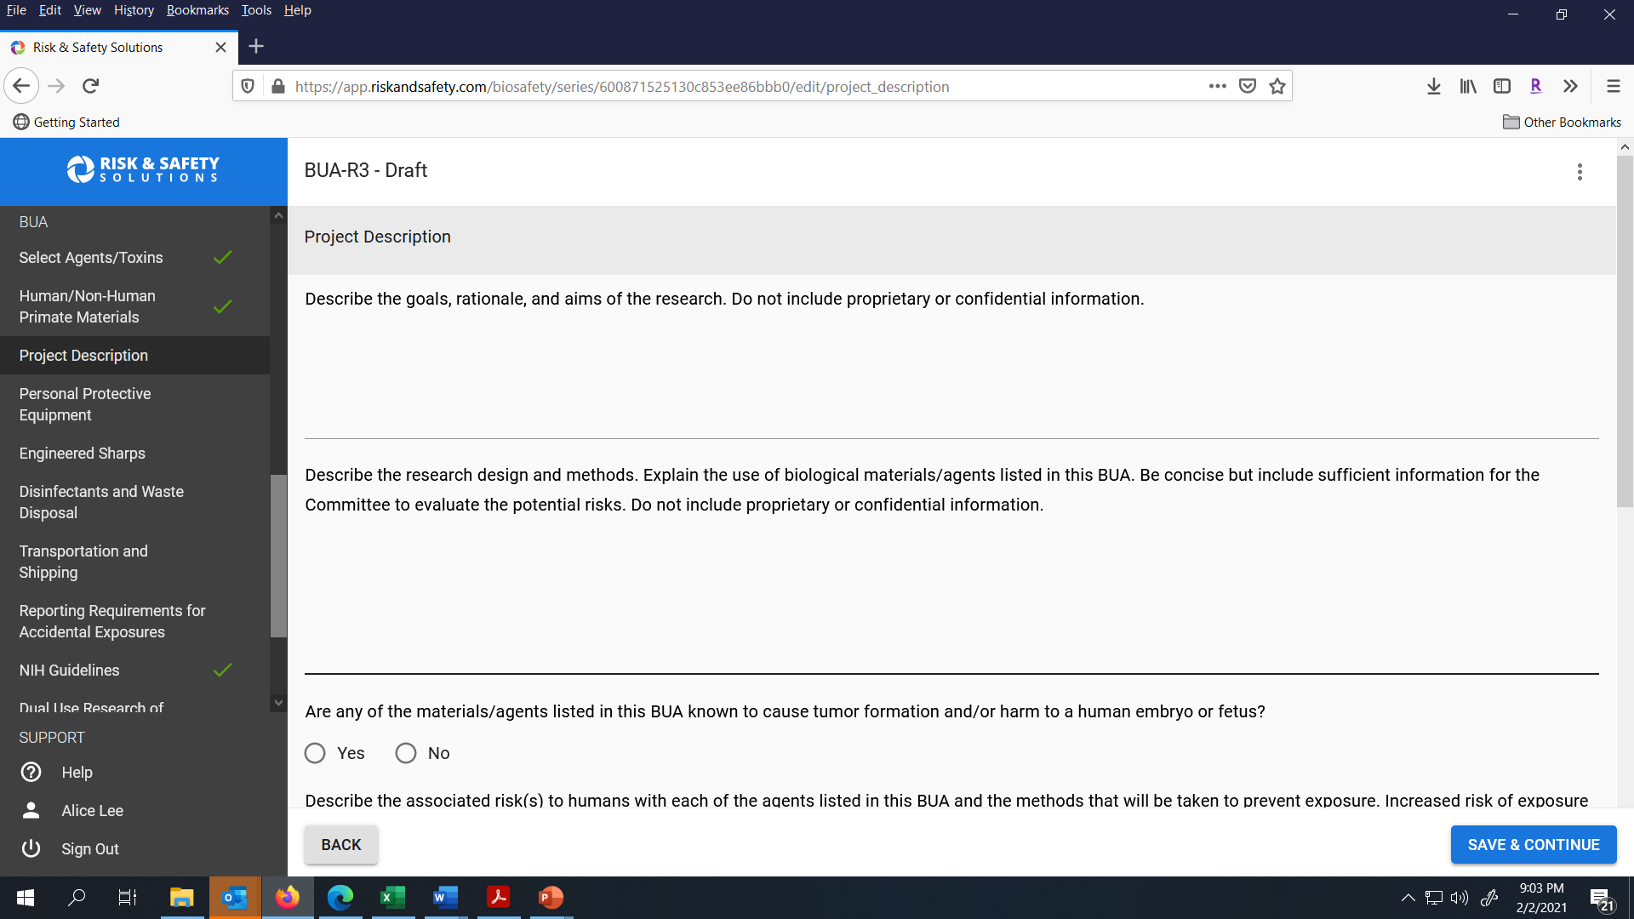
Complete the Project Description section by describing the research goals, design and methods. Click Save & Continue to go to the next section.

Slide 27
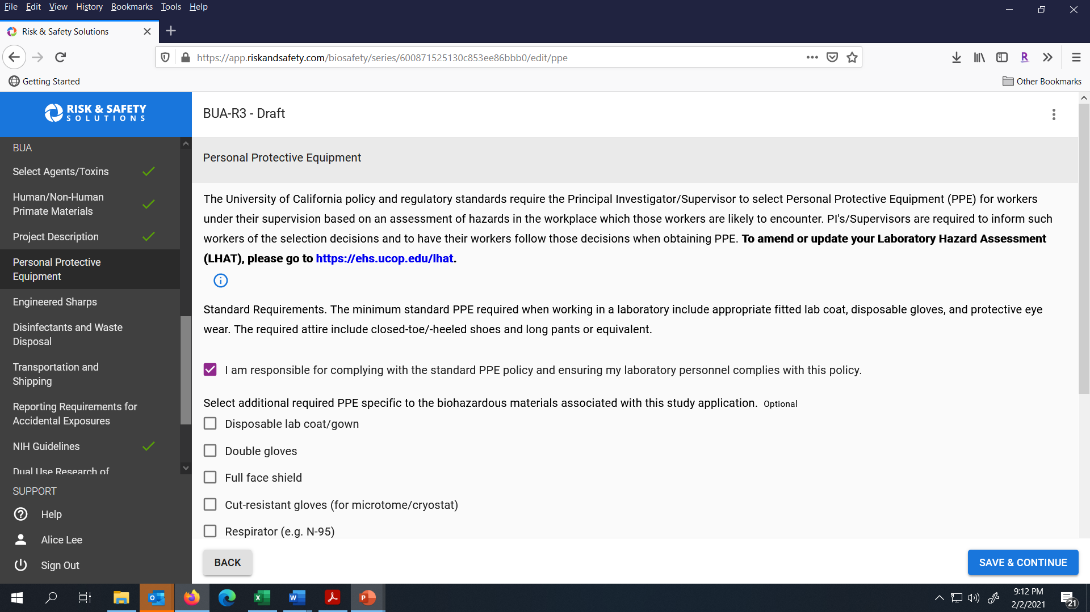
Complete the Personal Protective Equipment (PPE) Section and confirm your lab is using the Standard Requirements. Click Save & Continue to go to the next section.

Slide 28
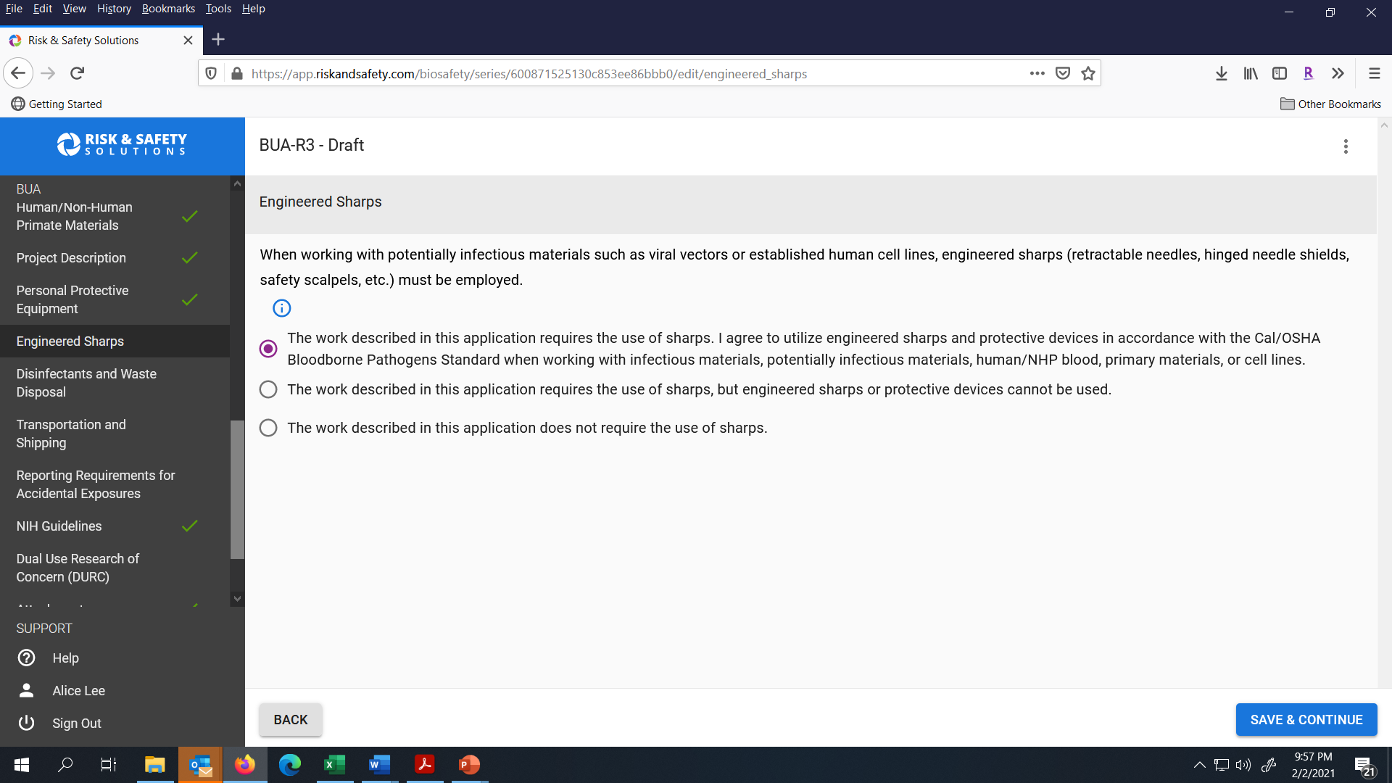
Complete the Engineered Sharps Section and click Save & Continue.

Slide 29
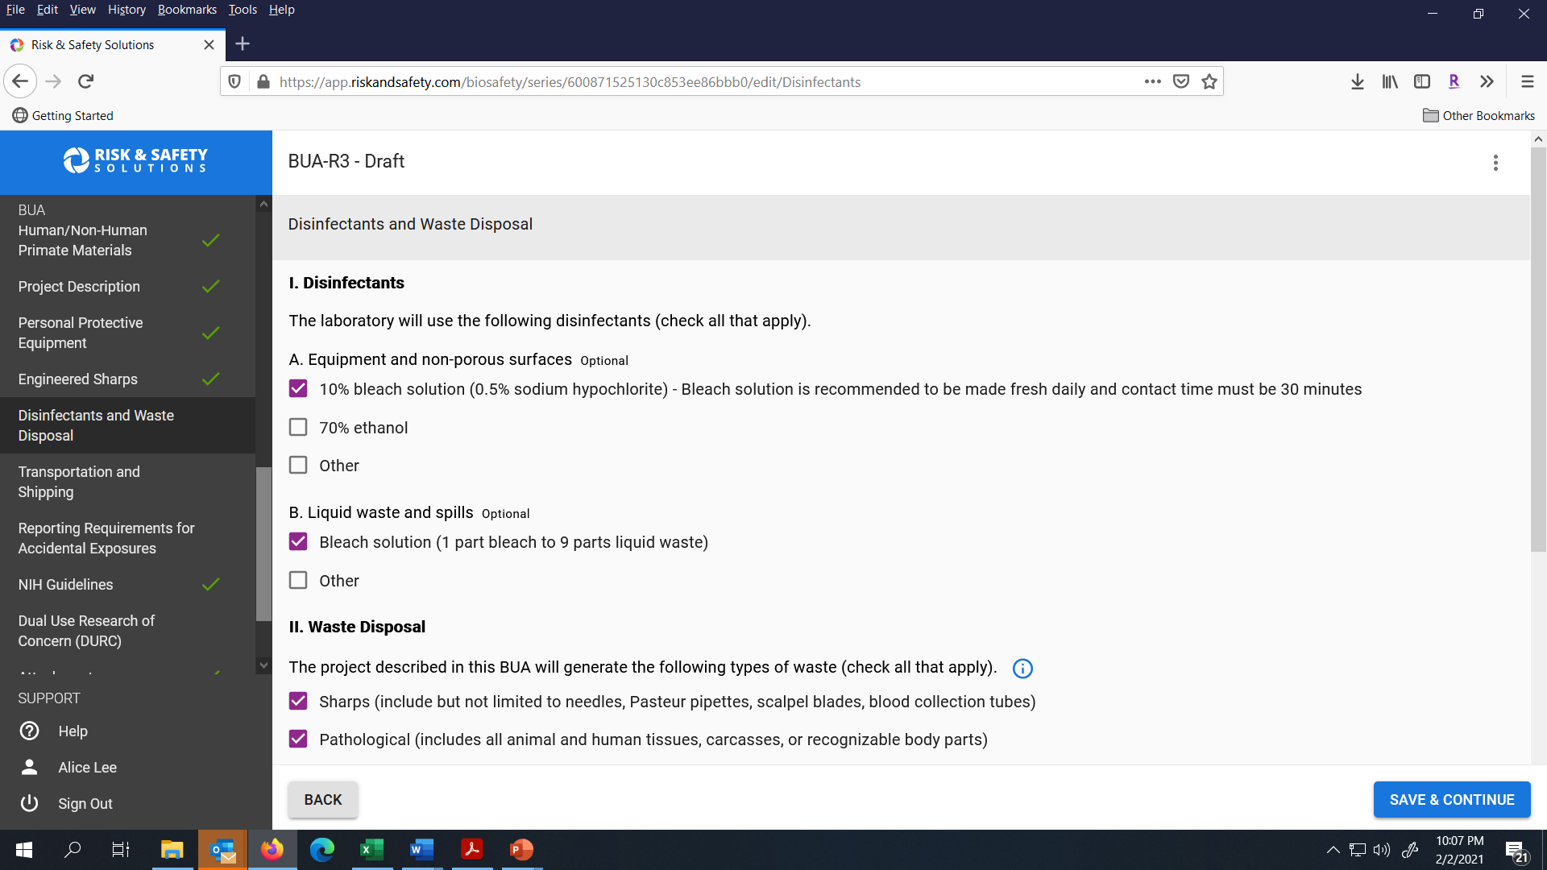
Complete the Disinfectant and Waste Disposal section and click Save & Continue.

Slide 30
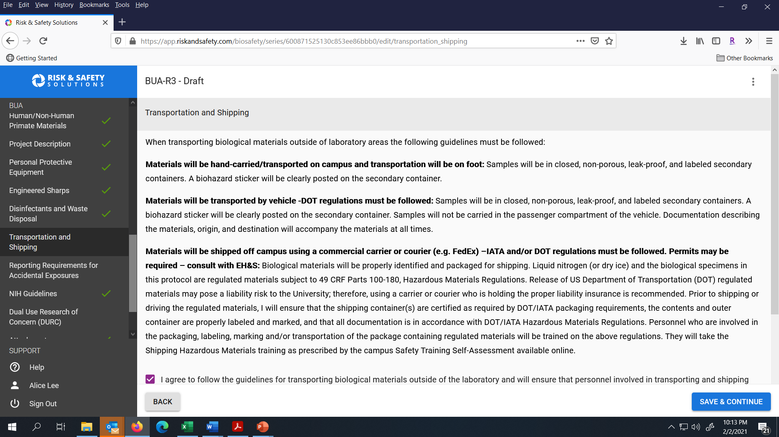
Complete the Transportation and Shipping section and confirm that the lab will follow the guidelines for transporting biological materials outside the lab. Click Save & Continue to go to the next section.

Slide 31
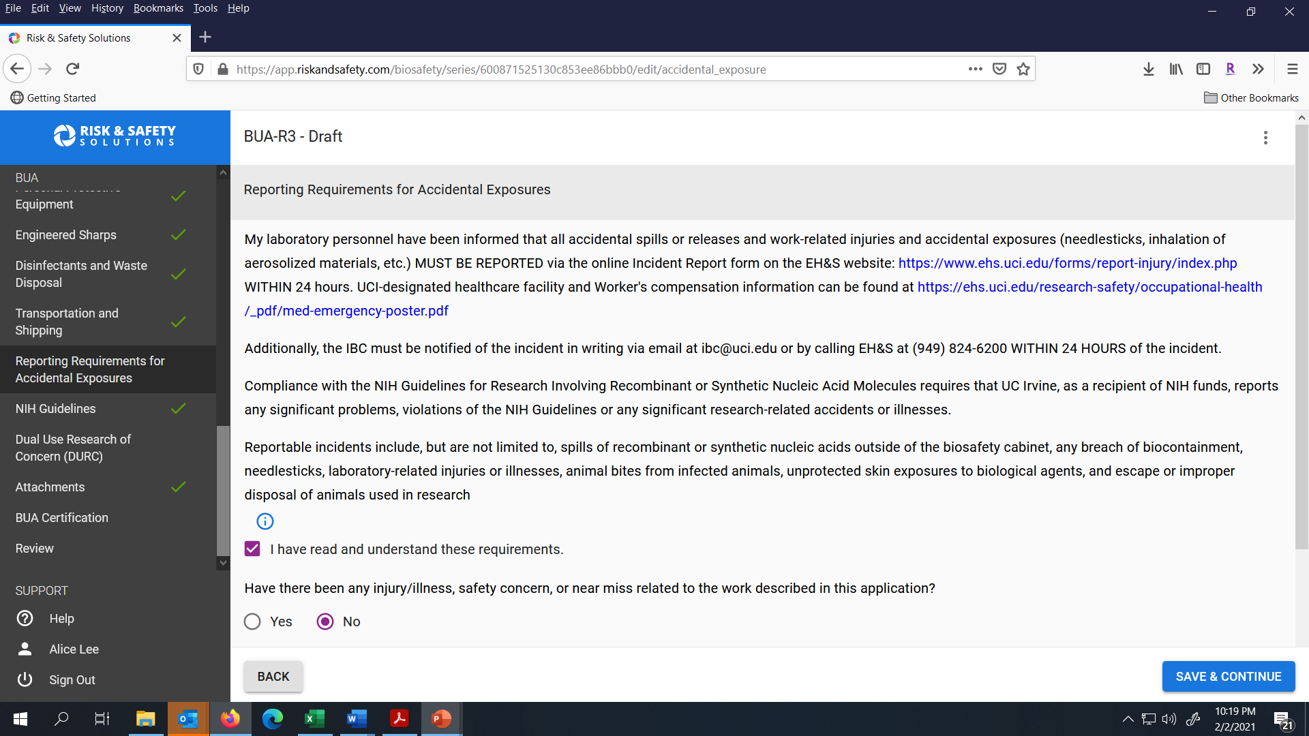
Complete the Reporting Requirements for Accidental Exposures section and click Save & Continue.

Slide 32
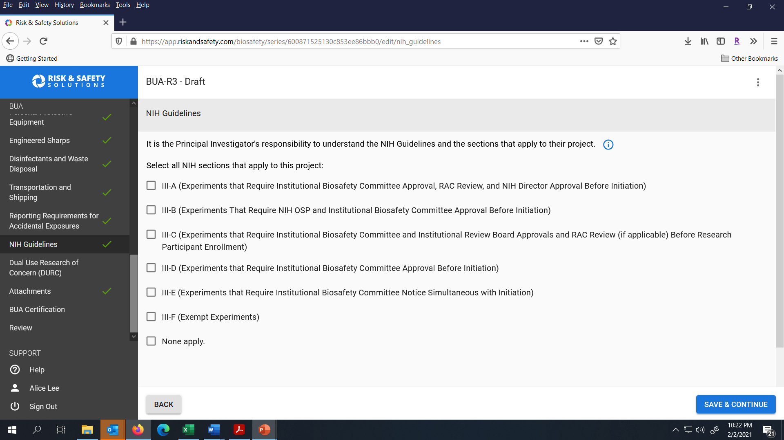
Indicate the NIH Guidelines that are applicable to your work. Click Save & Continue to go to the next section.

Slide 33
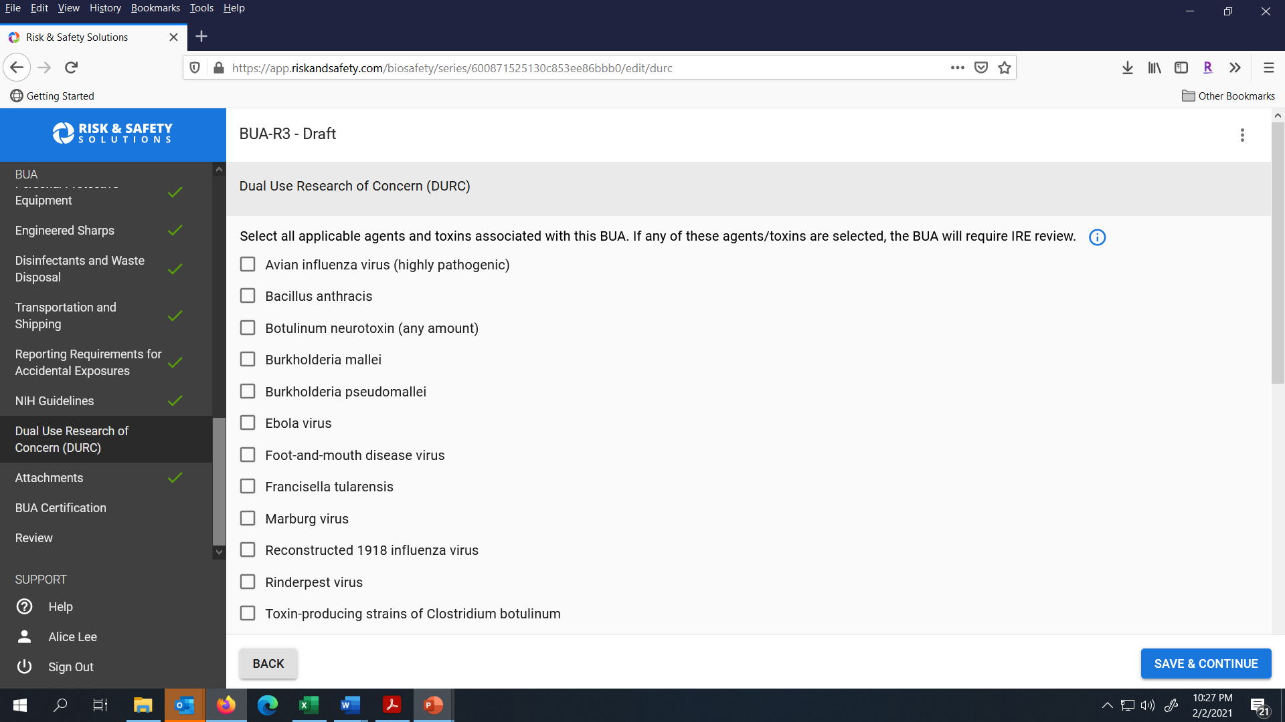
Complete the Dual Use Research of Concern section and then click Save & Continue to go to the next section.

Slide 34

For the Attachments section, upload any supporting documents for your BUA. Click Save & Continue to go to the next section.

Slide 35
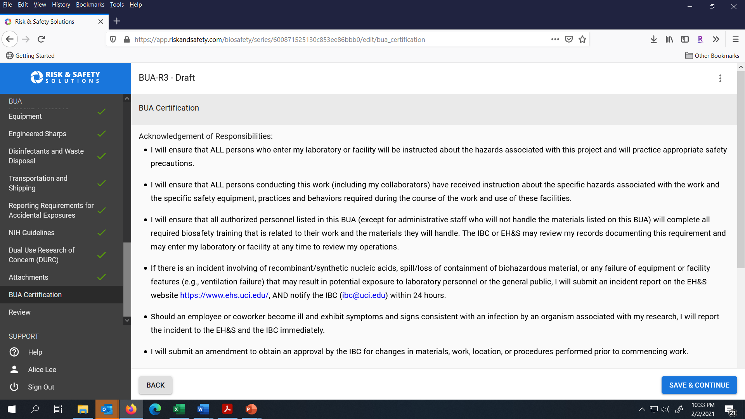
Complete the certification for your BUA. Click Save & Continue to go to the next section.

Slide 36
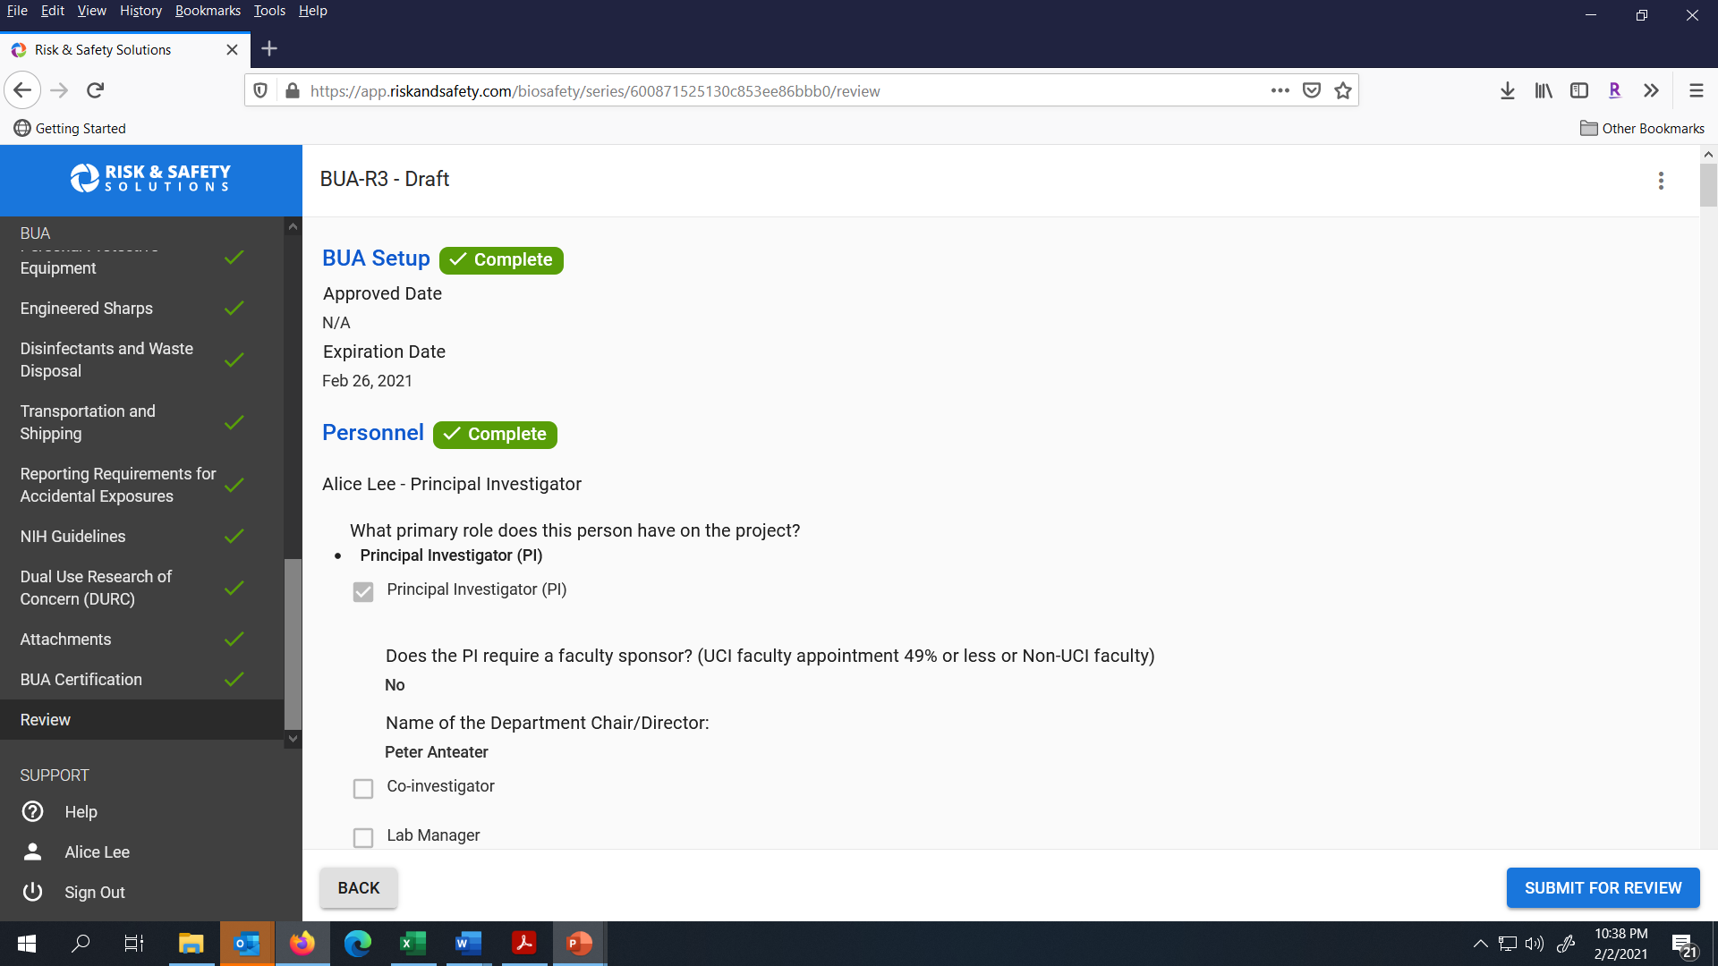
Please review the summary of your BUA and use the left navigation menu if you need to access specific sections. Click Submit for Review when you are ready to submit the BUA to the IBC Administrator.

Slide 37
Quick facts about the IBC BUA review process
The Institutional Biosafety Committee (IBC) meets the 3rd Wednesday of each month to review BUA’s for the work being performed on campus.
A Biosafety Inspection (BI) of your study locations will be done in conjunction with the IBC’s review. Biosafety will contact you or your designee to schedule the BI.
Questions? Please contact ibc@uci.edu.

Slide 38
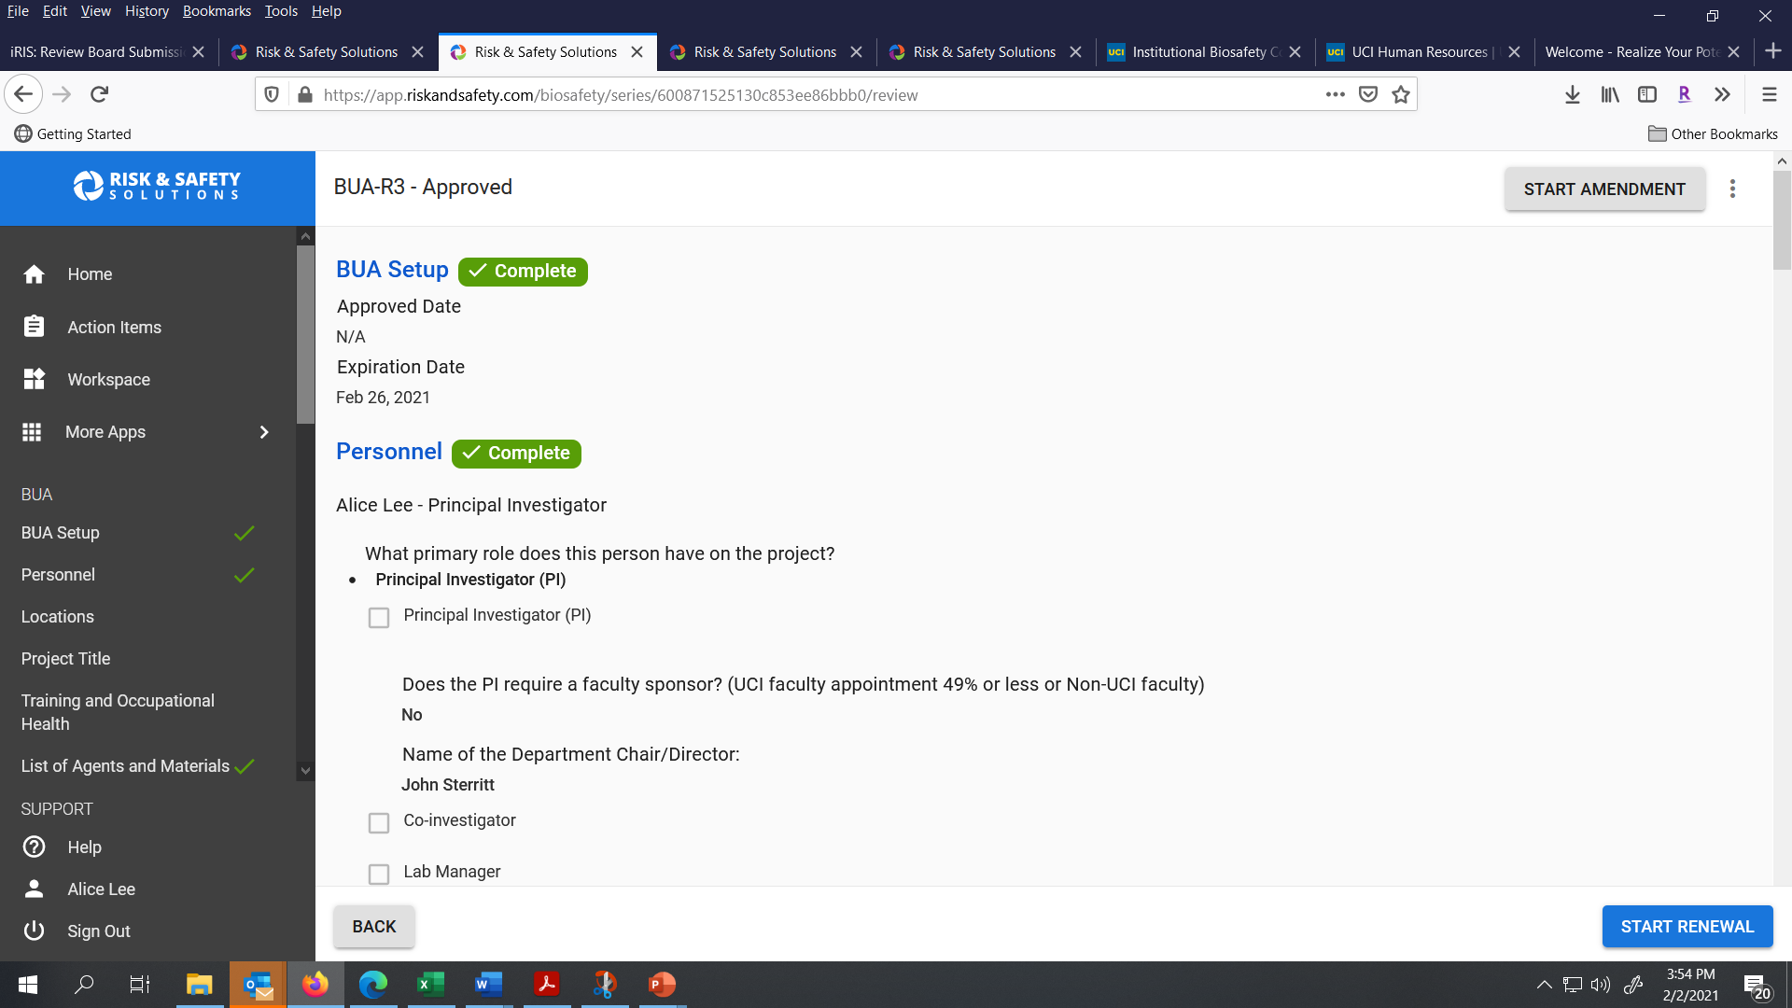
If you are renewing your BUA, select the Renewal button in the lower right corner of the page.

Slide 39
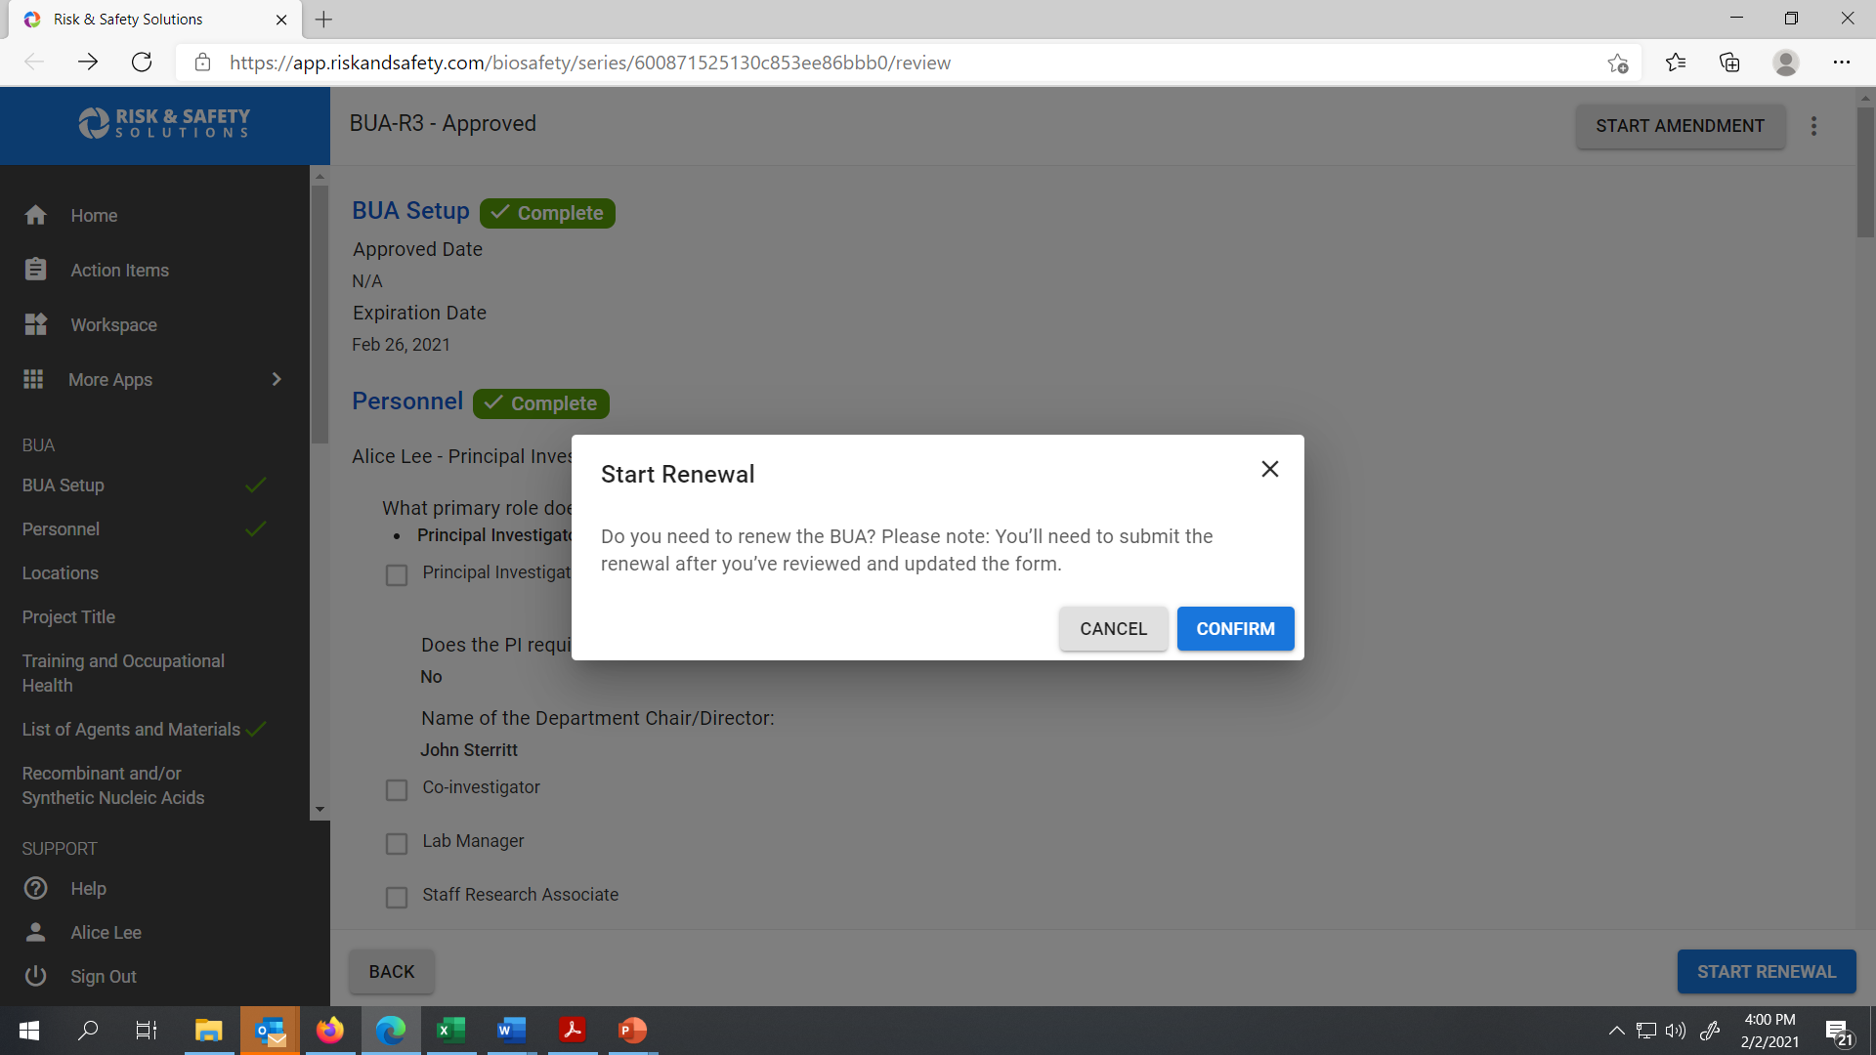
Click Confirm to start your renewal.

Slide 40

For Renewals, provide the Project Title and project summary.

