Slide 1
How to Submit
an Amendment to
your Biological Use
Authorization (BUA)

Slide 2
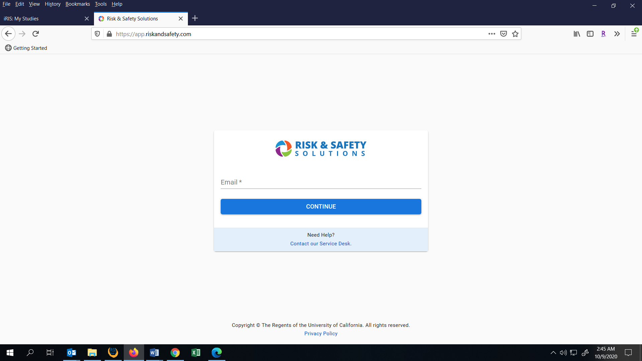
Log into RSS-BIO at: https://app.riskandsafety.com

Slide 3
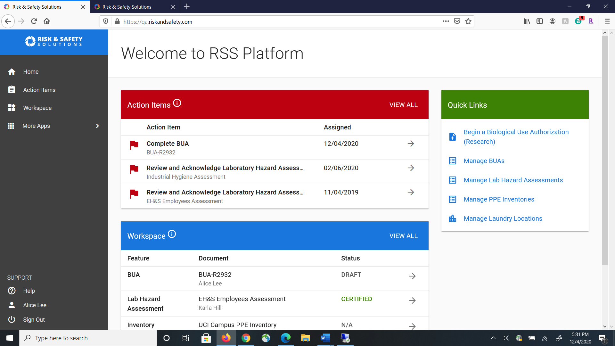


Click on More Apps and then Biosafety to access RSS-BIO and your BUA.

Slide 4
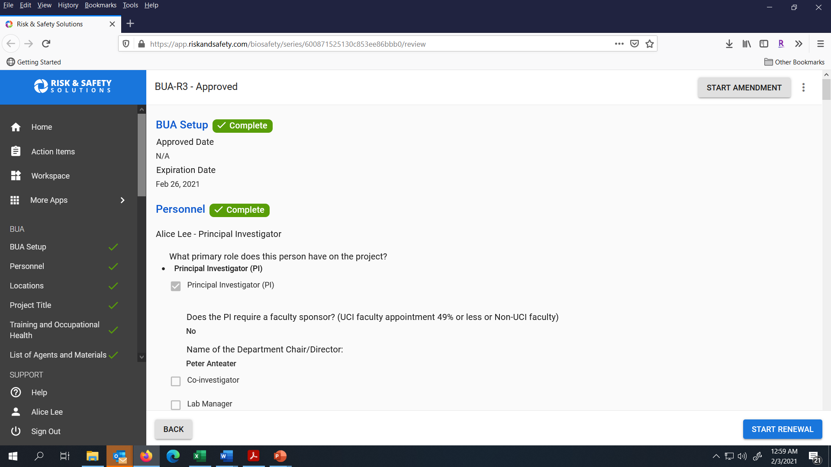
Select Start Amendment in the upper right corner of the page.

Slide 5
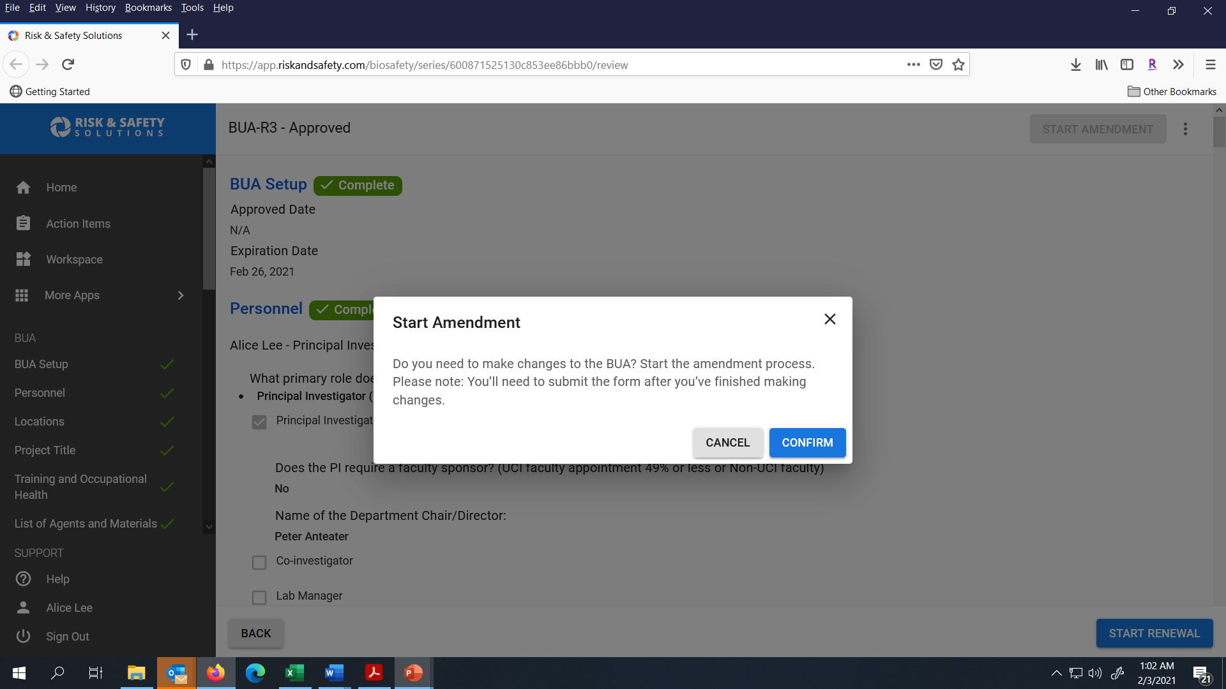

Click Confirm to start your Amendment.

Slide 6
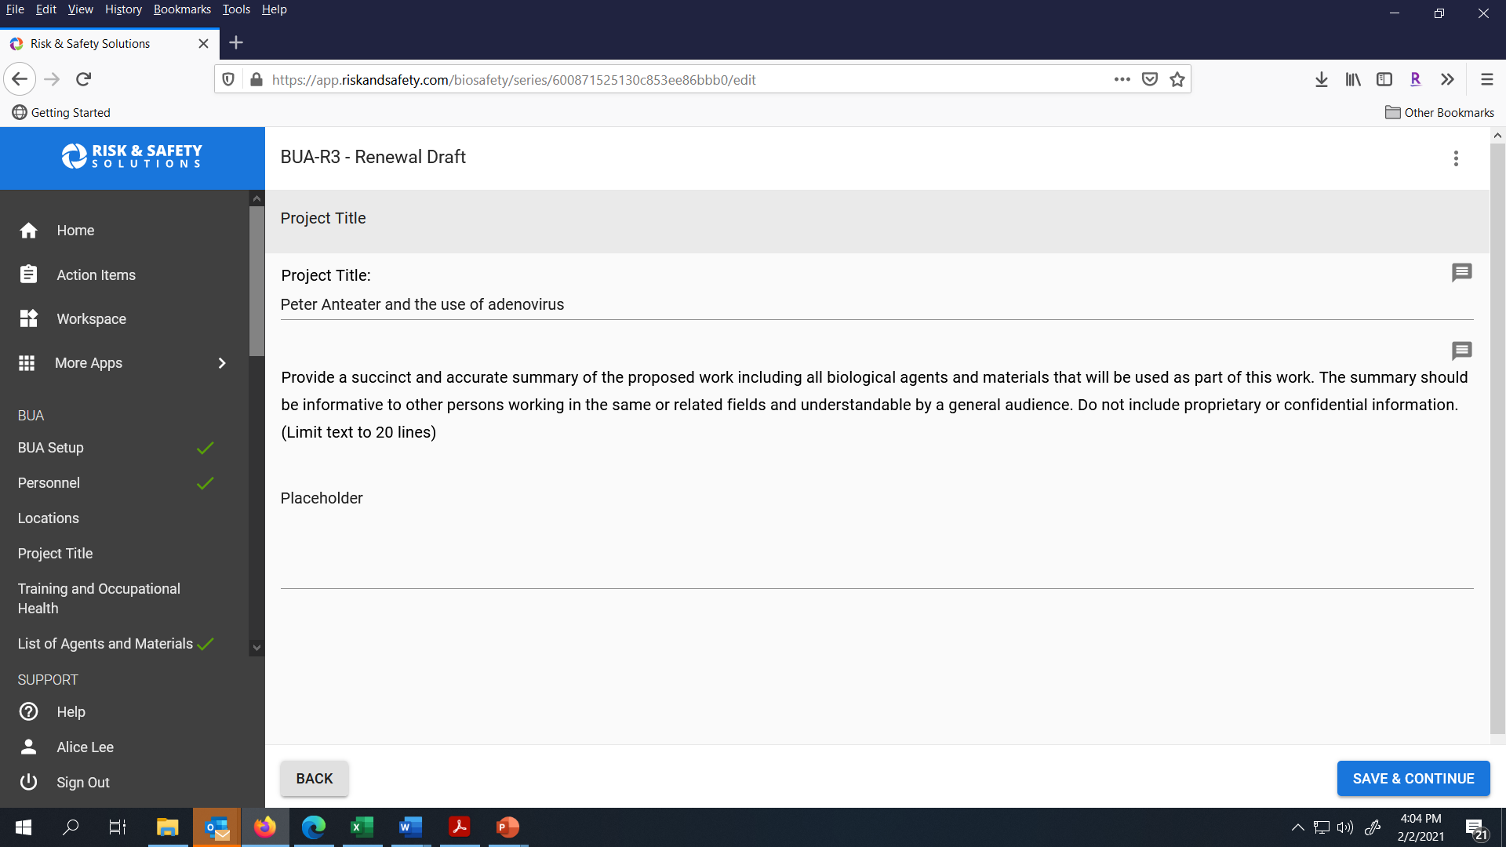
Review the Project Title and Summary, make any needed changes and click Save & Continue to go to the next section.

Slide 7
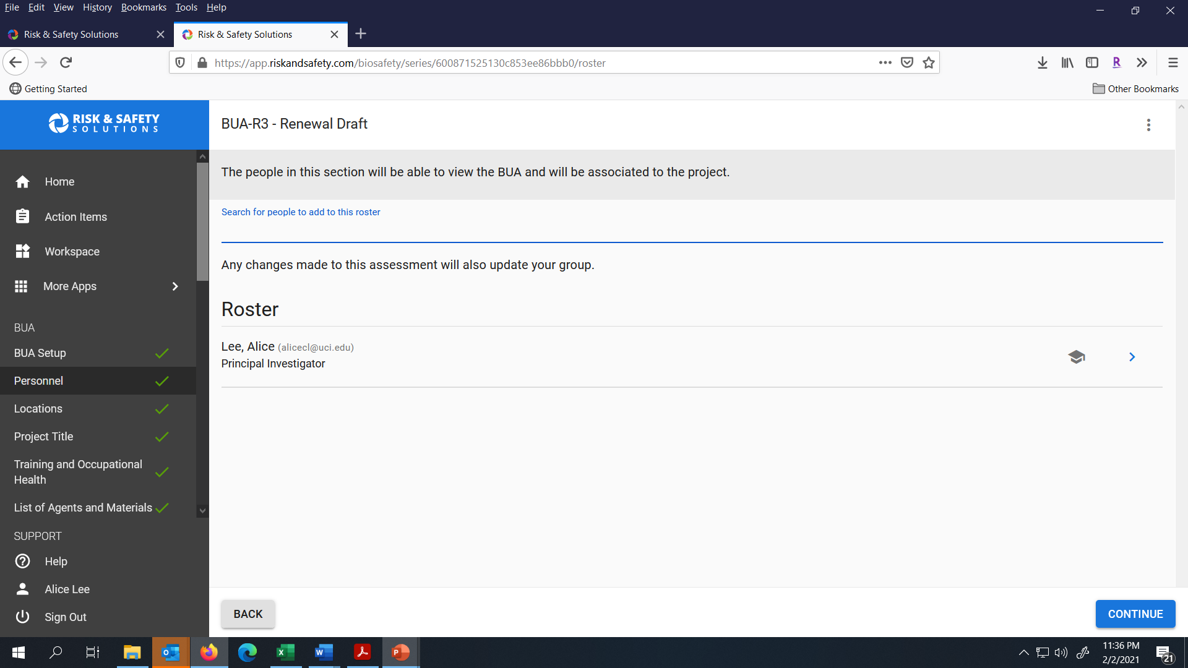
If you need to make any updates to Personnel or Locations, use the left navigation menu to access these sections.

Slide 8
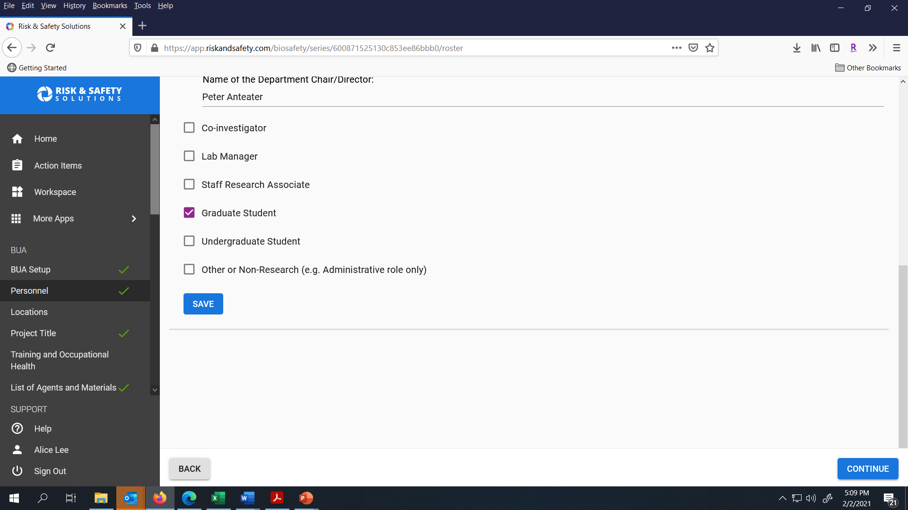
To add new personnel, type in the person’s last name to search for them and click Save to add the person. Click Continue when you are ready to go to the next section.

Slide 9
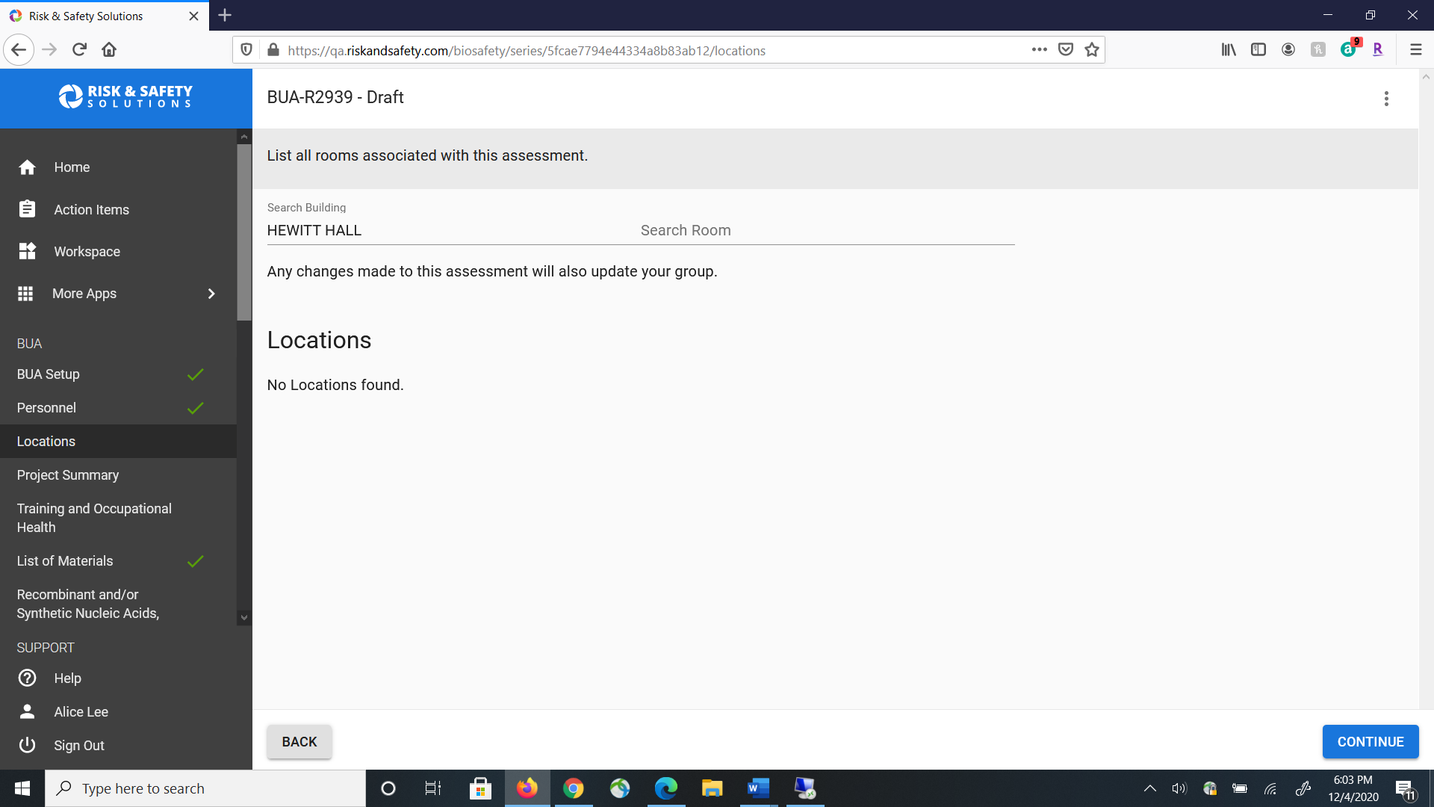
To add a new Study Location, enter the building name under Search Building and then the Room number in the Search Room field to pull up the location. If the system cannot bring up your building name or room number, please contact ibc@uci.edu.

Slide 10
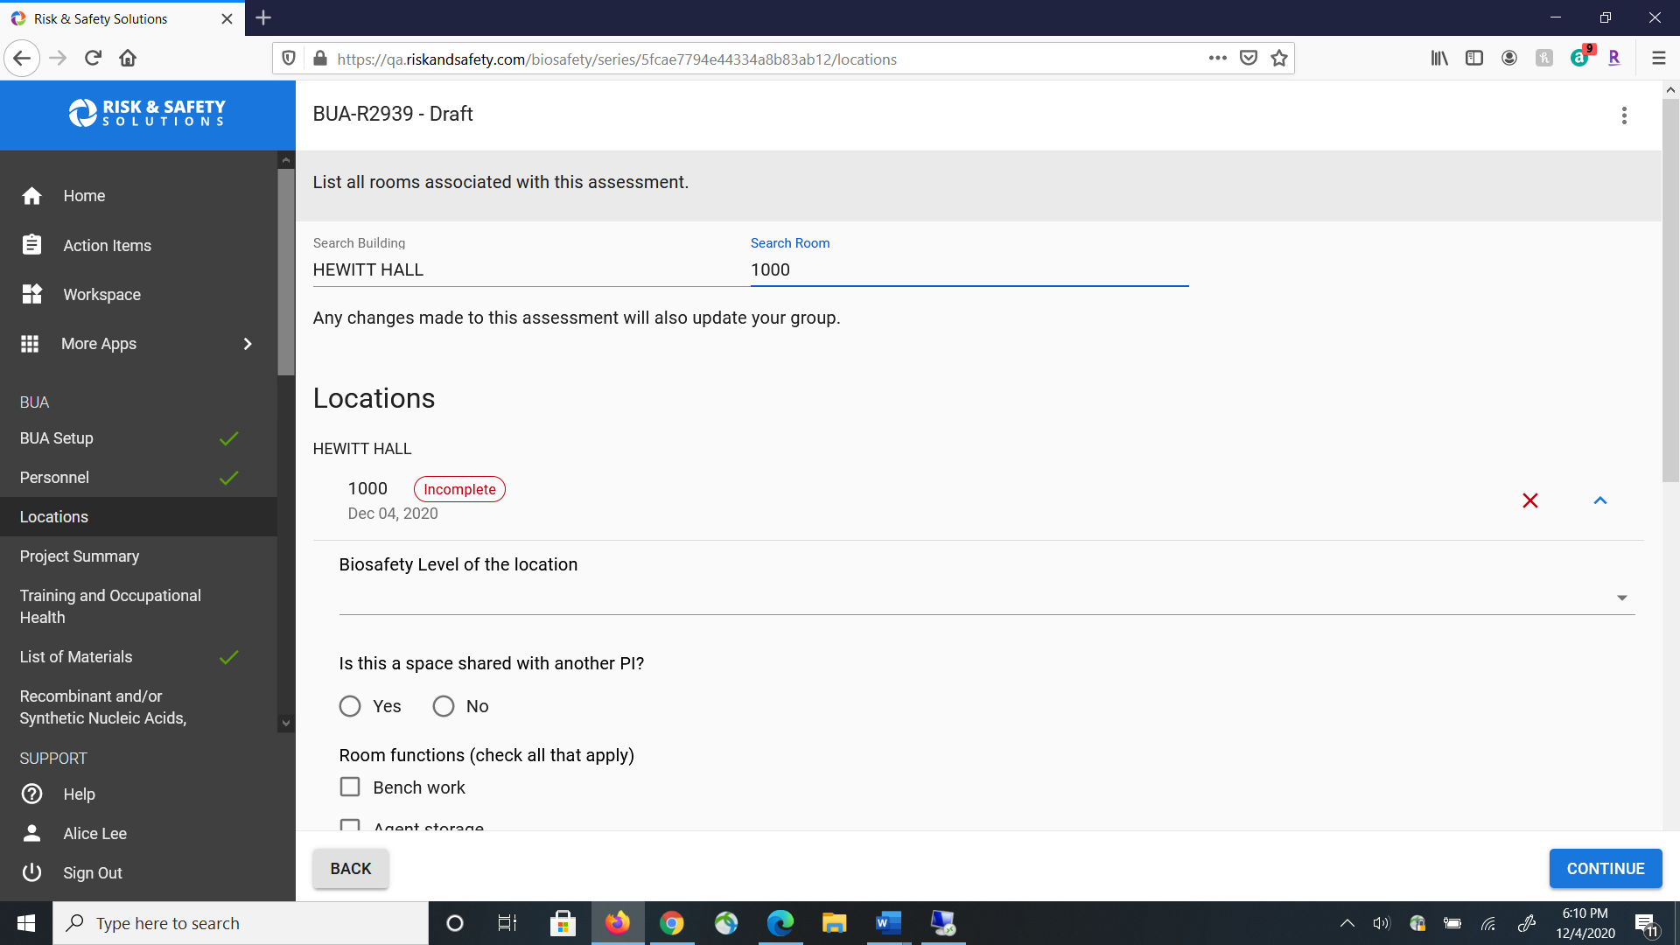
Provide the requested information for the
Study Location.

Slide 11
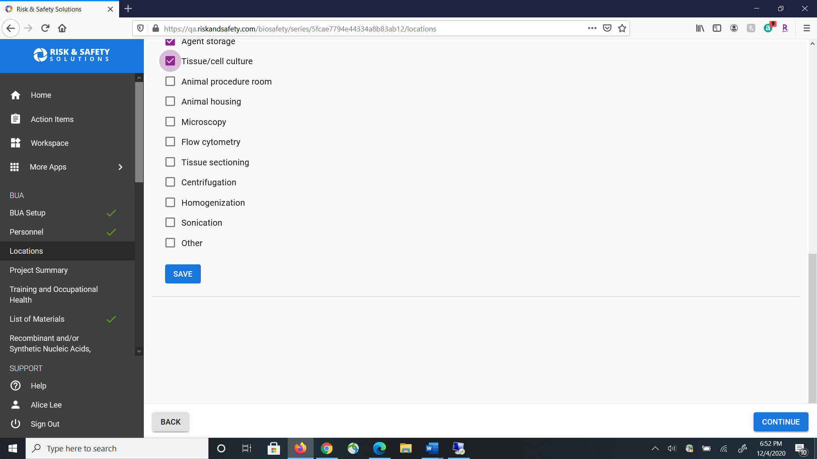

Click Save to add this study location to your BUA and then click Continue to go to the next section.

Slide 12
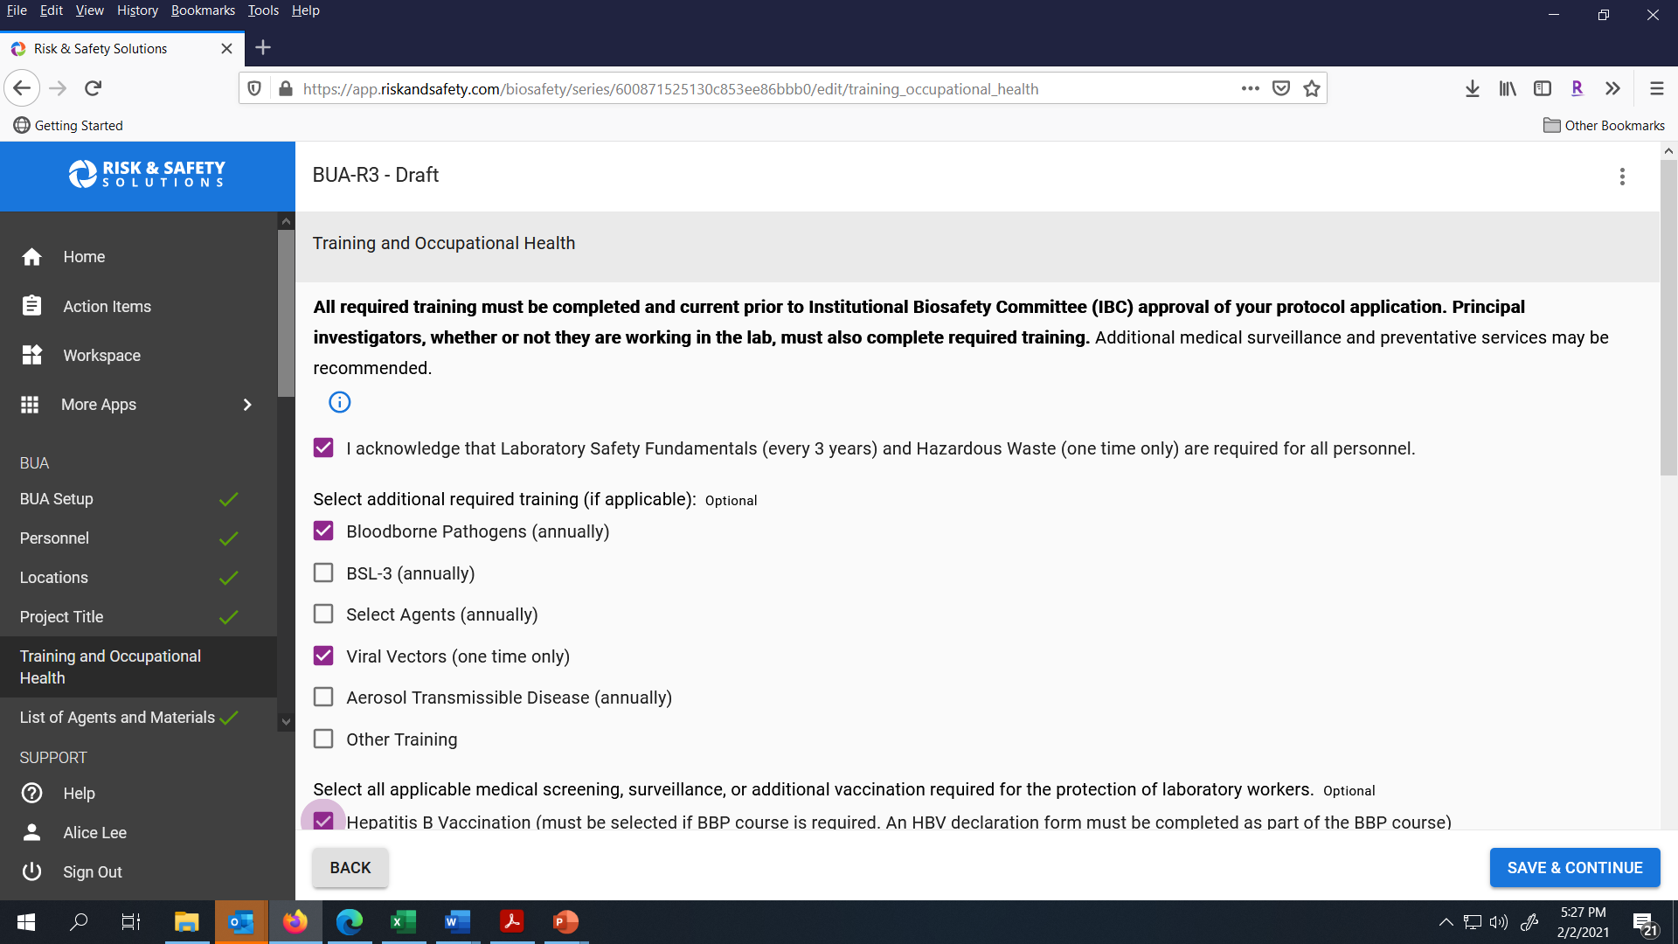
Review the Training and Occupational Health information for your BUA, make any needed changes and then click Save & Continue to go to the next section.

Slide 13
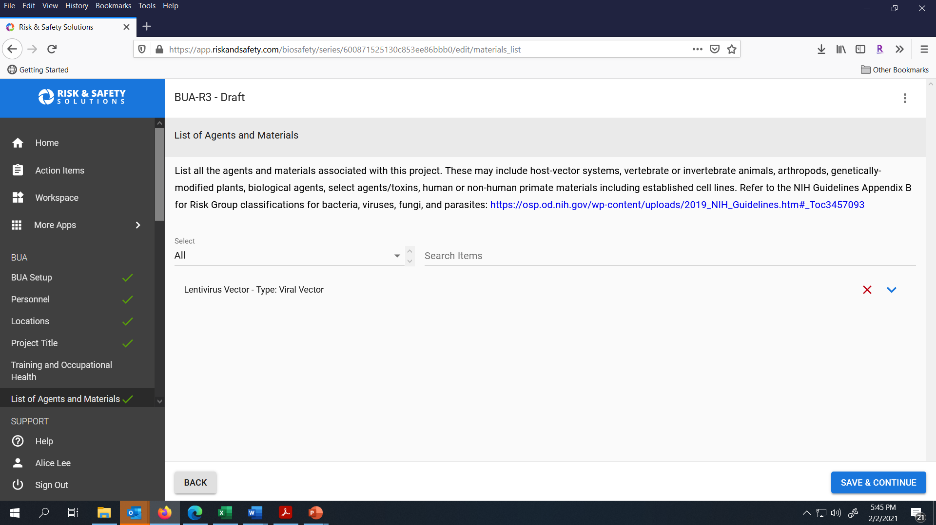
Update the list of agents and materials used by your study and make any needed changes. Click Save & Continue to move to the next section.

Slide 14

To add a new agent, type the agent name into the Search Items field.

Slide 15
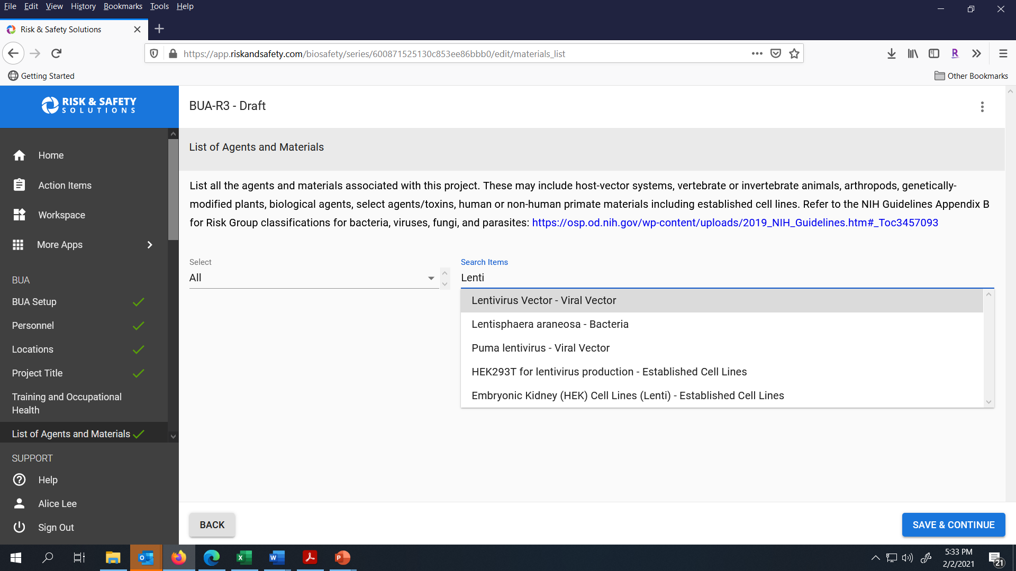
Then click on the correct name in the dropdown menu.

Slide 16
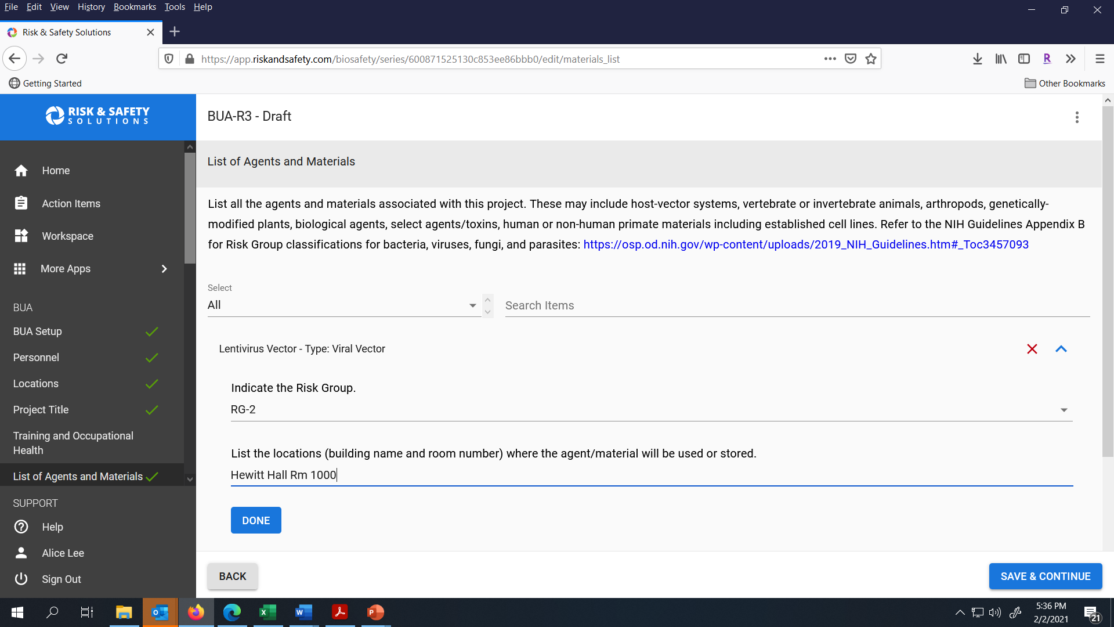
Provide the Risk Group and locations of the agent and click Done. Click Save & Continue to go to the next section.

Slide 17
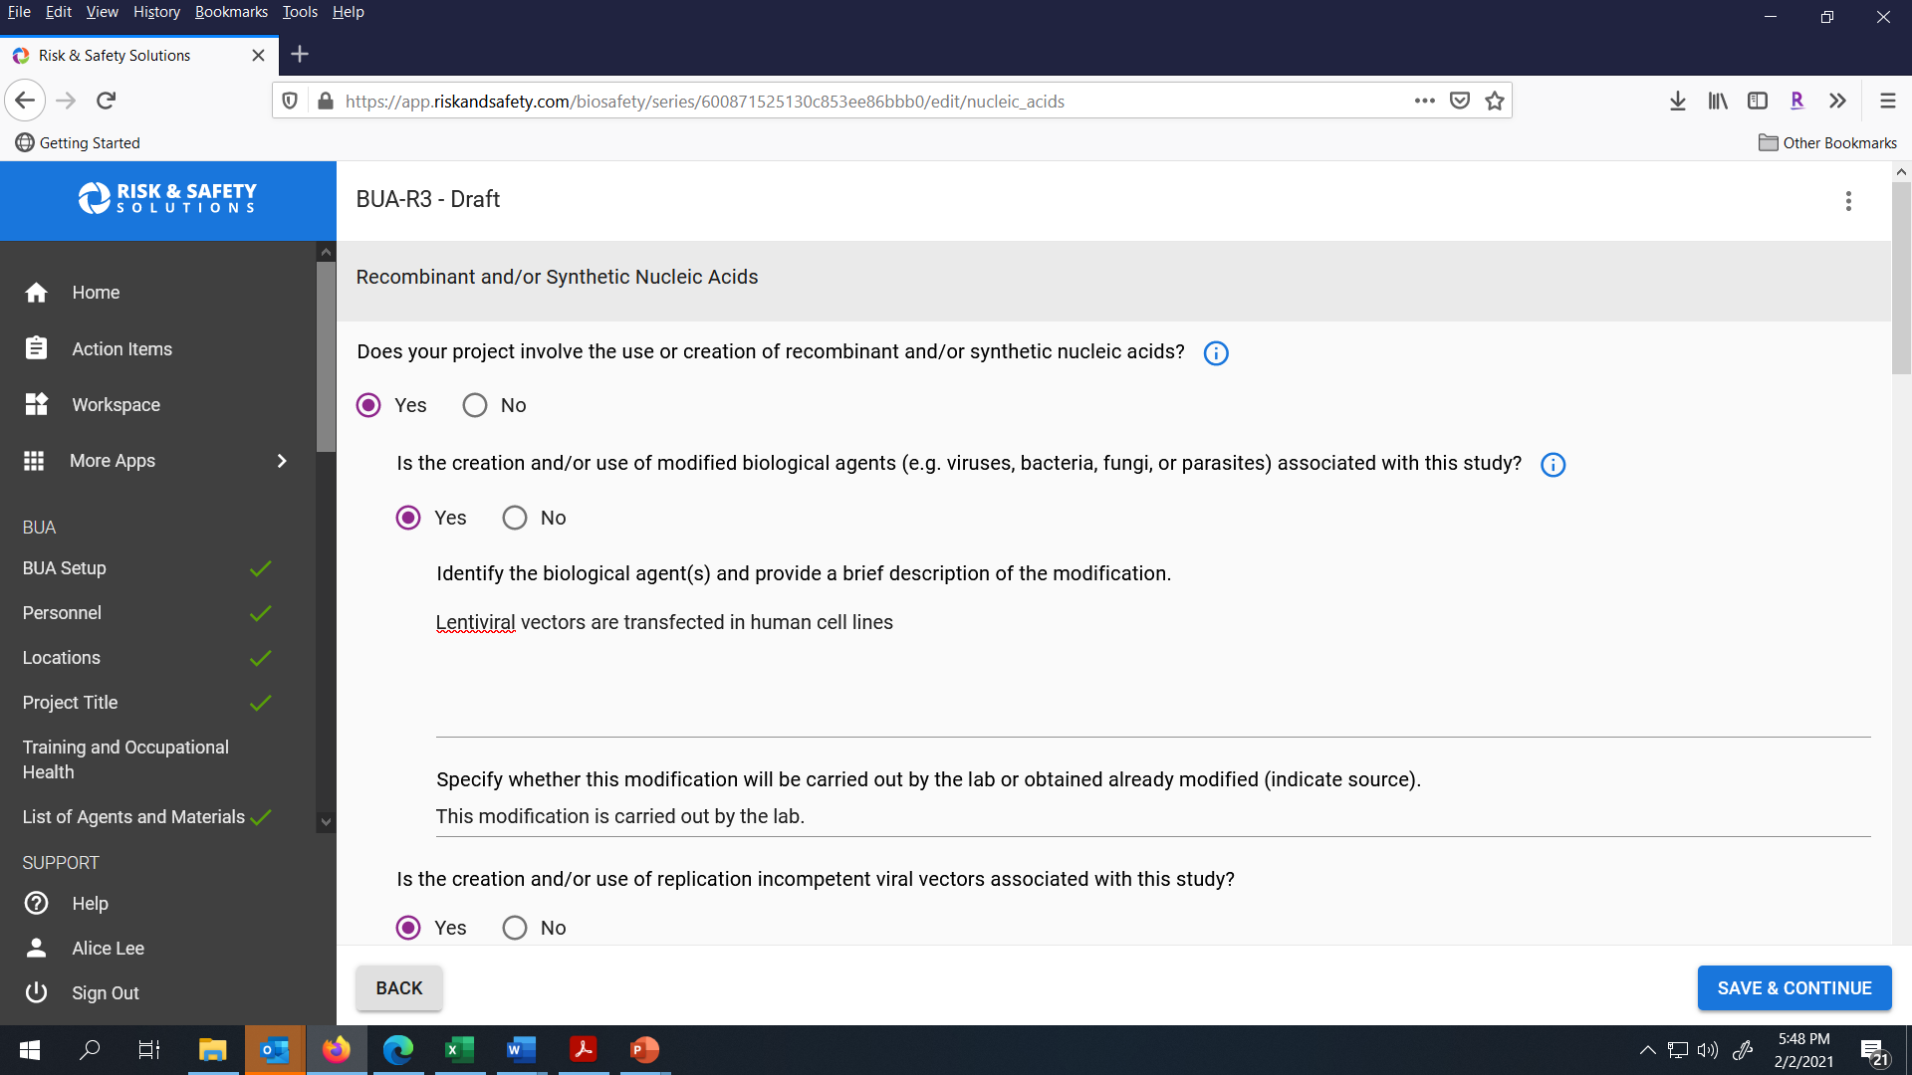
Review the Use of Recombinant and/or Synthetic Nucleic Acids section, make any updates needed and then click Save & Continue.

Slide 18
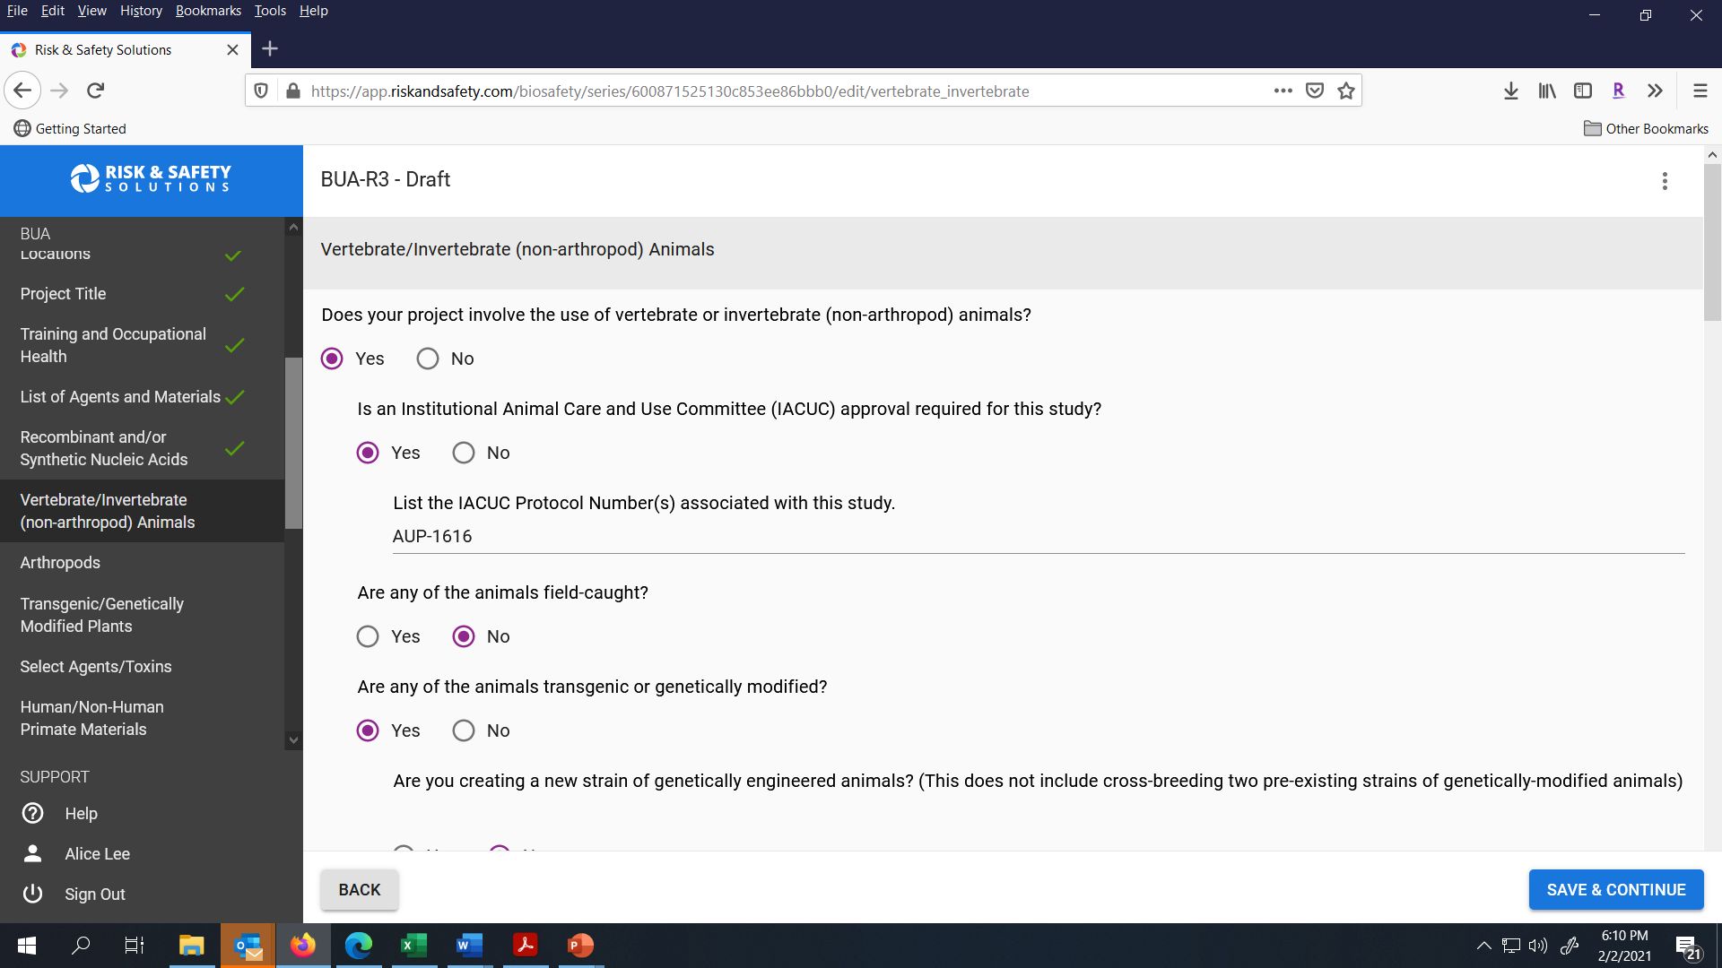
Review the Vertebrate/Invertebrate Animals section, make any needed changes and click Save & Continue to go to the next section.

Slide 19
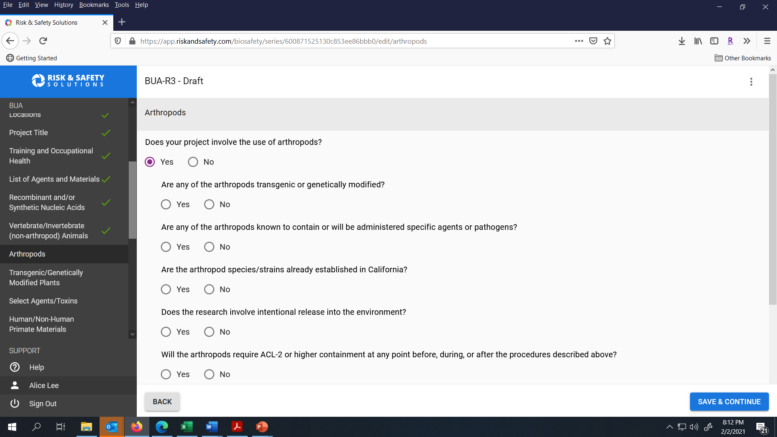
If applicable; update the Arthopods section and click Save & Continue to go to the next section.

Slide 20
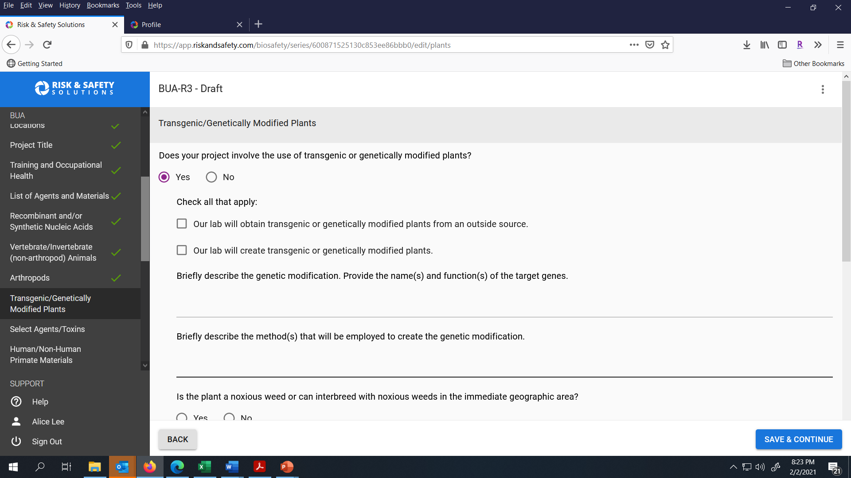
If applicable; update the Transgenic/ Genetically Modified Plants section and click Save & Continue to go to the next section.

Slide 21
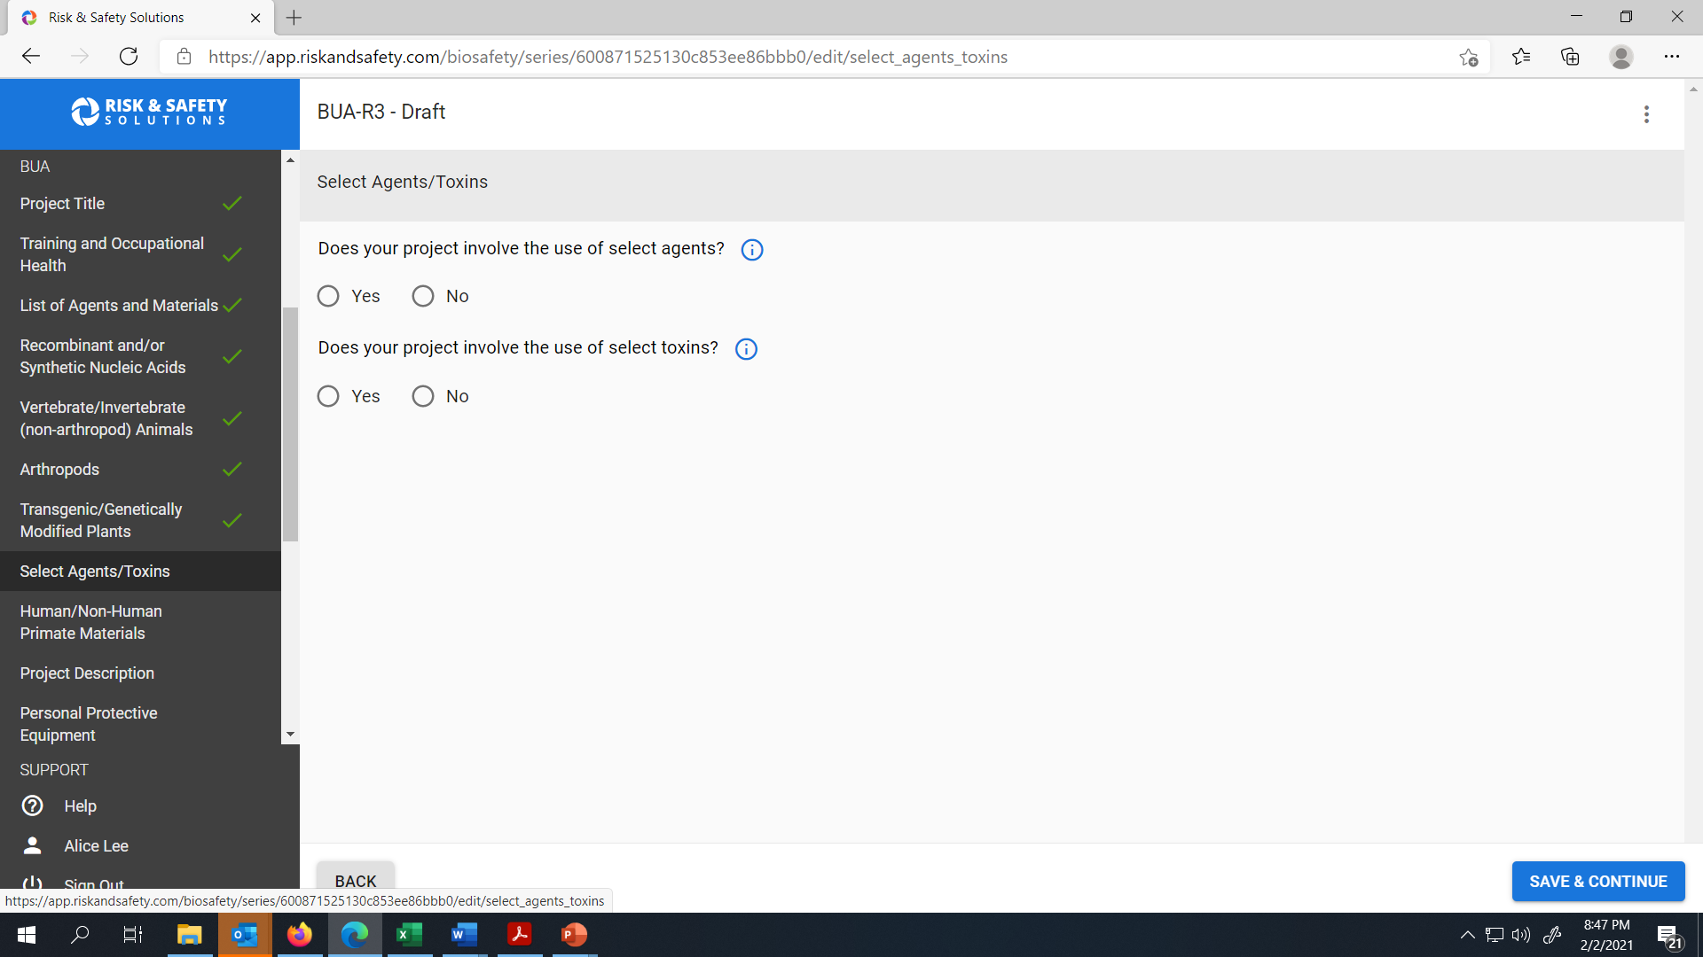
If applicable; update the Select Agents/ Toxins section and click Save & Continue to go to the next section.

Slide 22
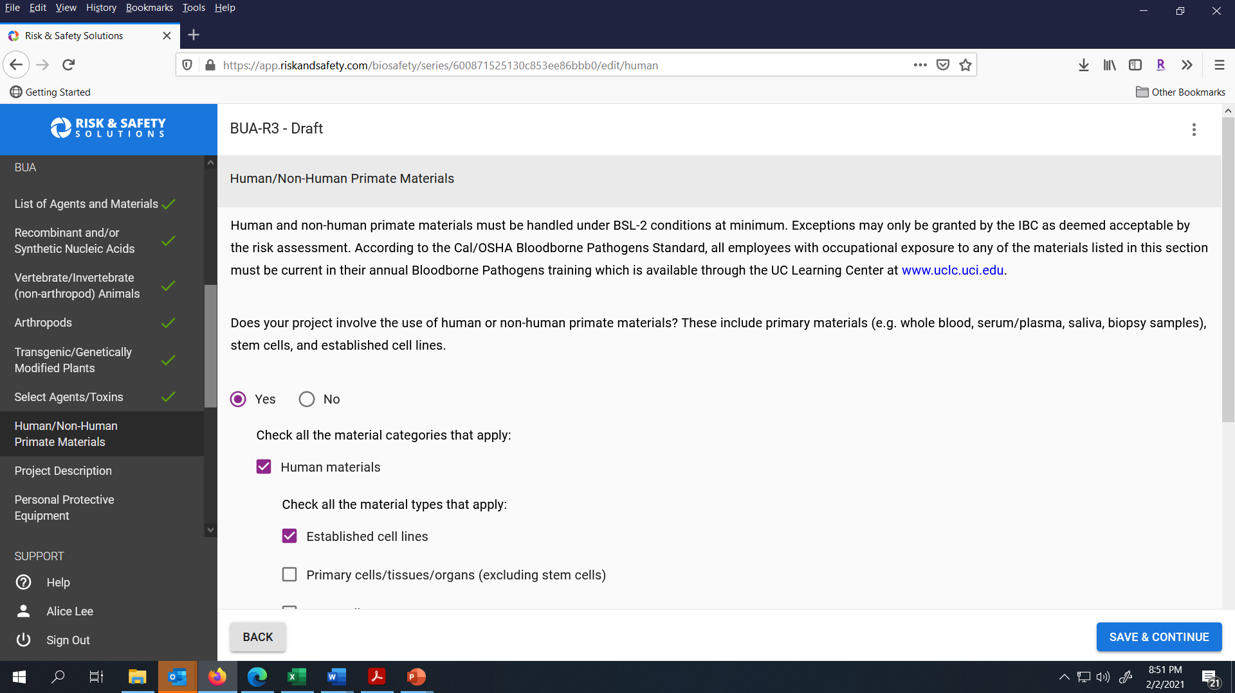
As needed, update the Human/ Non-Human Primate materials section. Click Save & Continue to go to the next section.

Slide 23
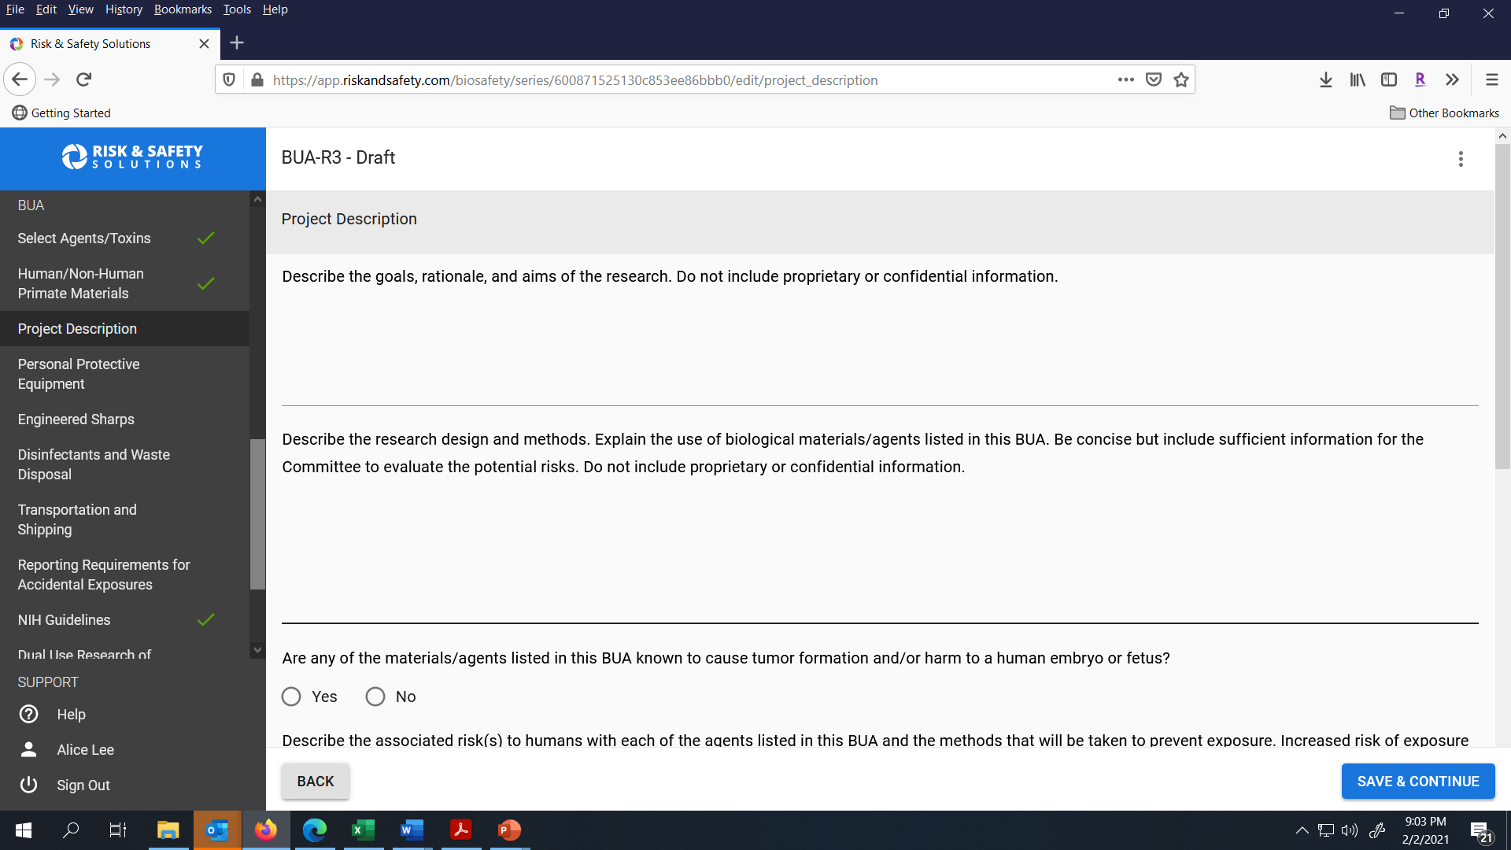
Review your Project Description section, make any needed updates and click Save & Continue to go to the next section.

Slide 24
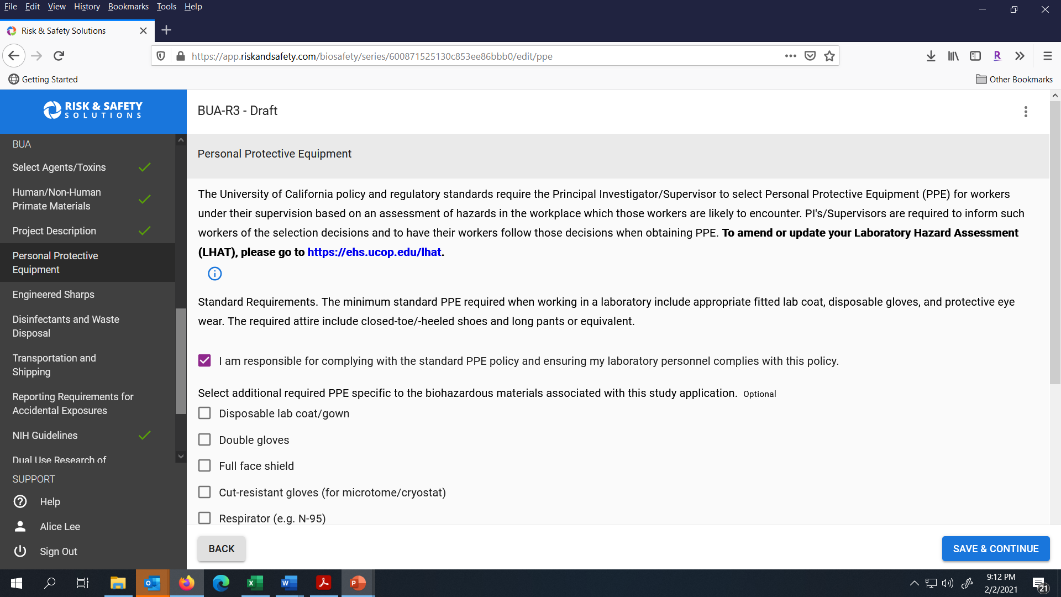
Review the Personal Protective Equipment (PPE) Section, make any needed updates and click Save & Continue to go to the next section.

Slide 25
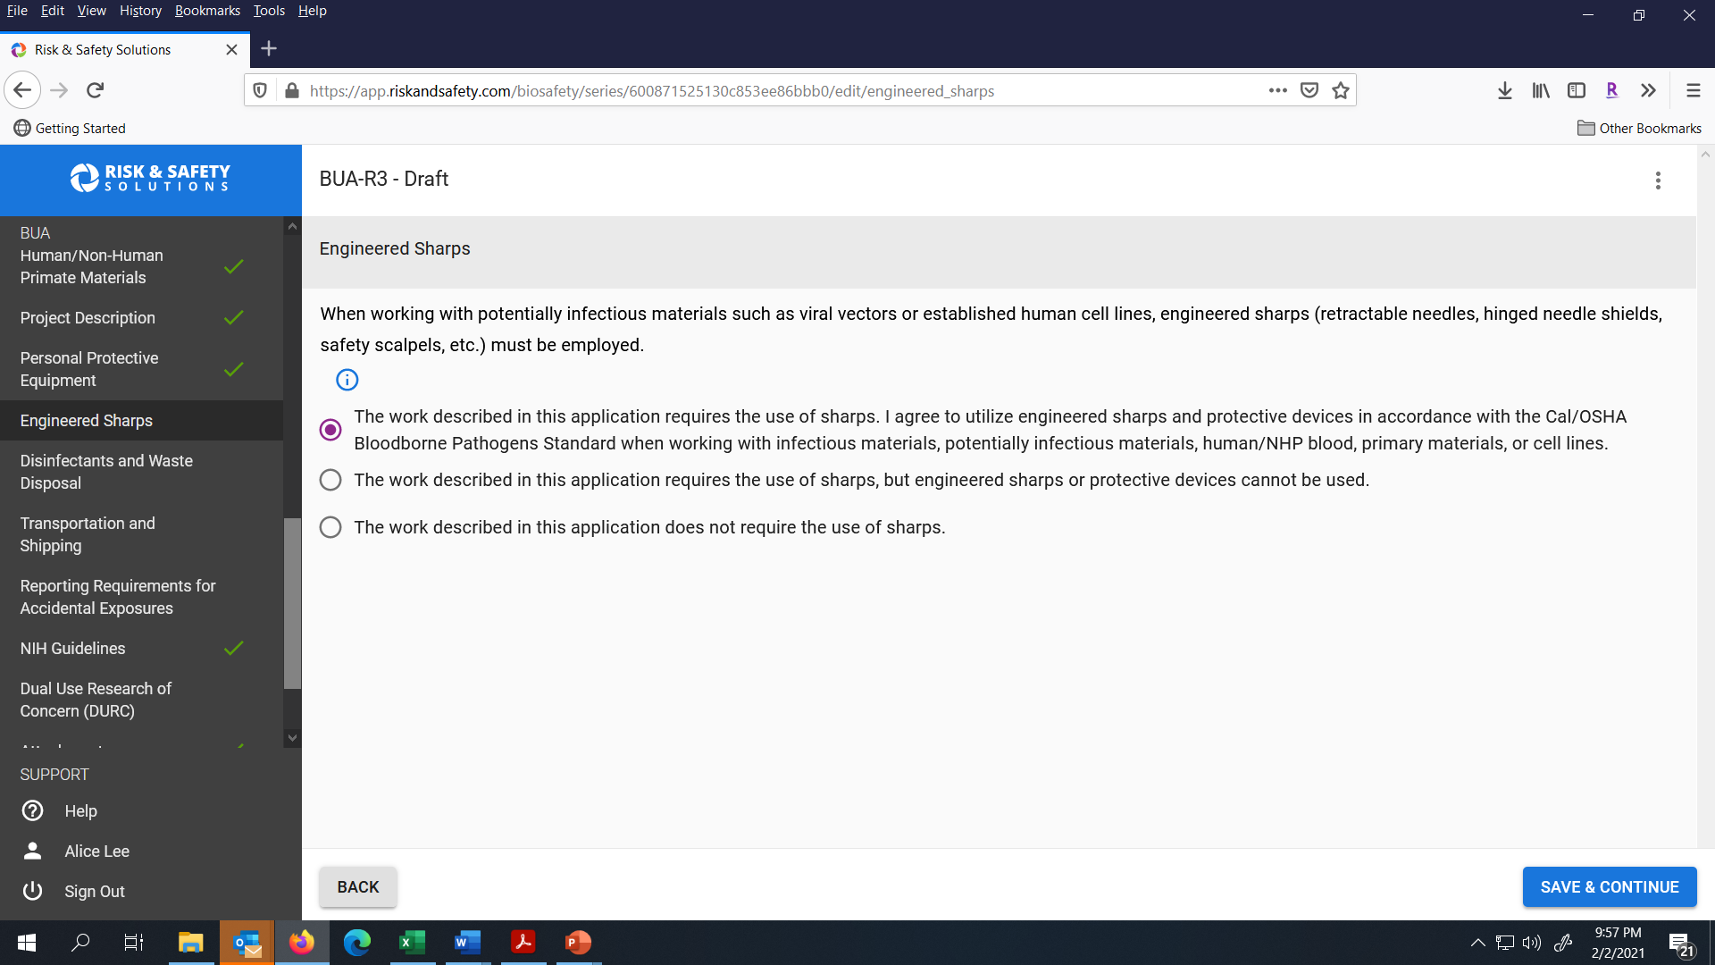
As needed, update the Engineered Sharps Section and click Save & Continue.

Slide 26
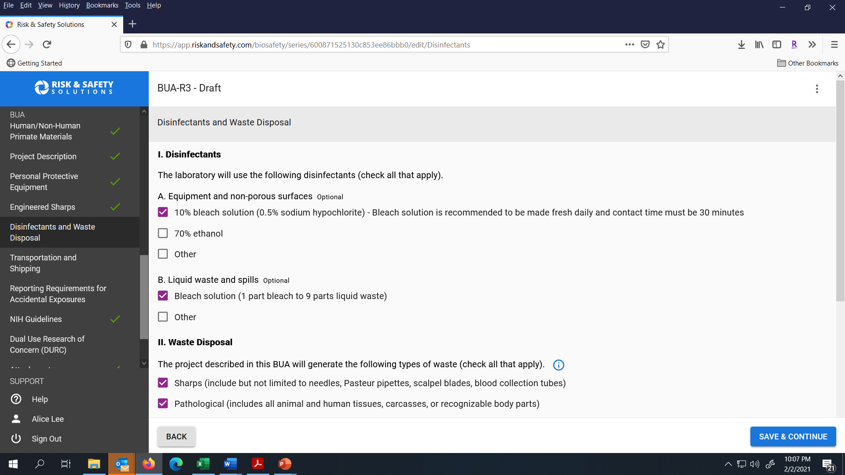
If needed, update the Disinfectant and Waste Disposal section and click Save & Continue.

Slide 27
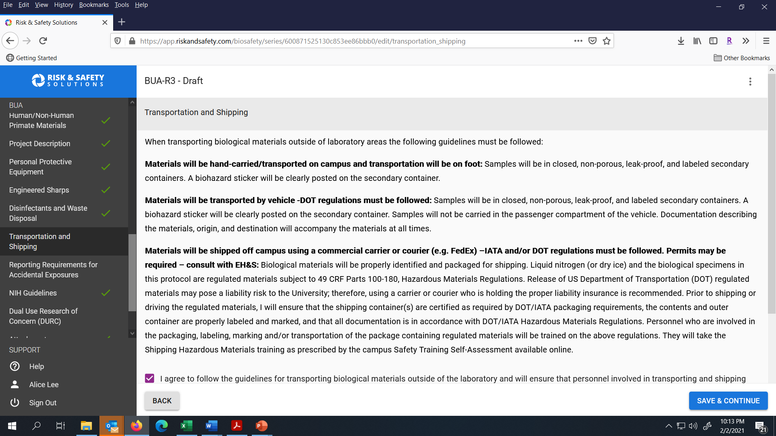
Review the Transportation and Shipping section and click Save & Continue to go to the next section.

Slide 28
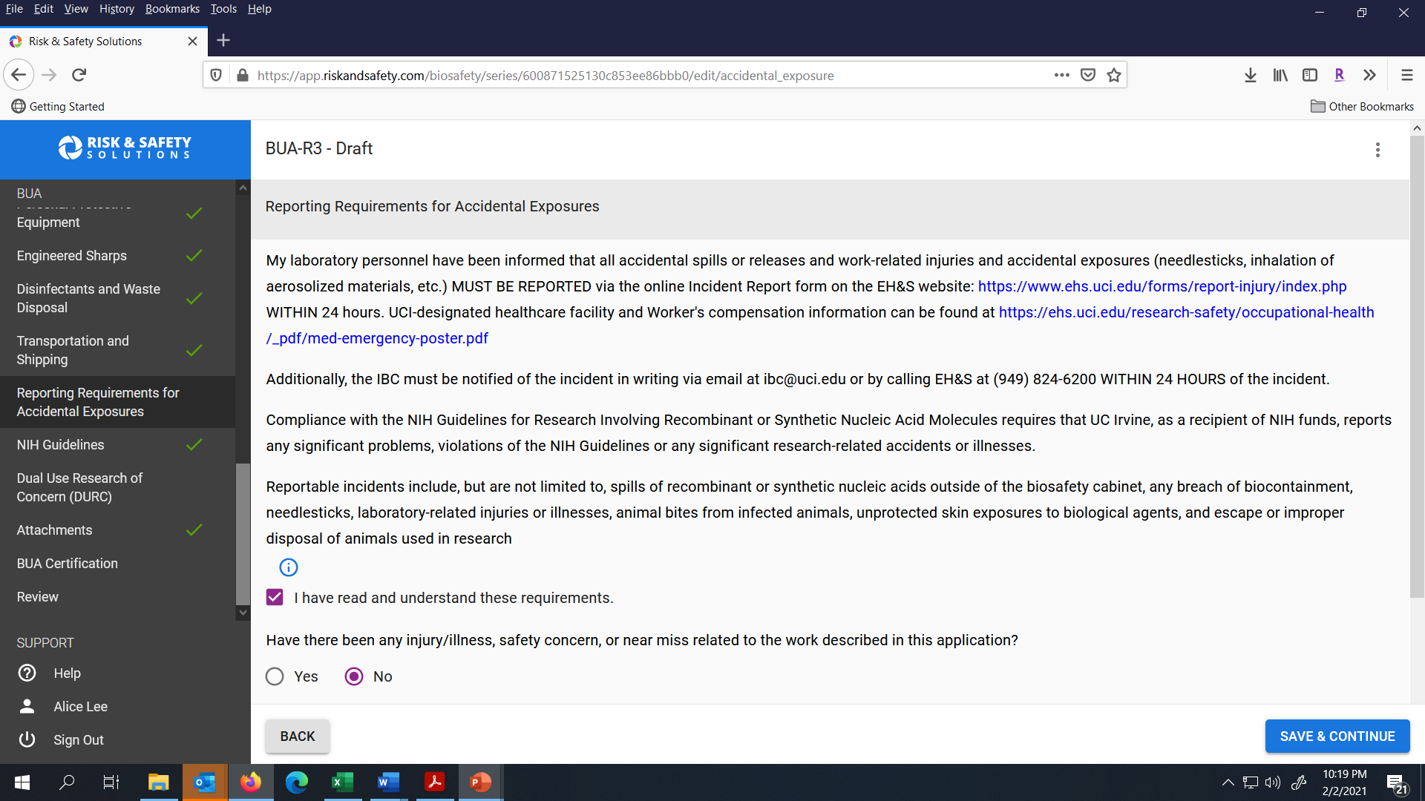
Review the Reporting Requirements for Accidental Exposures section and click Save & Continue.

Slide 29
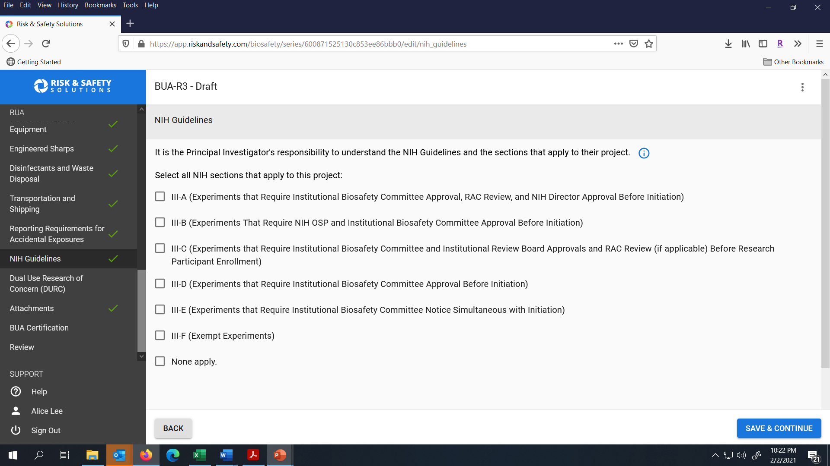
Review the NIH Guidelines that are applicable to your work and make any needed updates. Click Save & Continue to go to the next section.

Slide 30
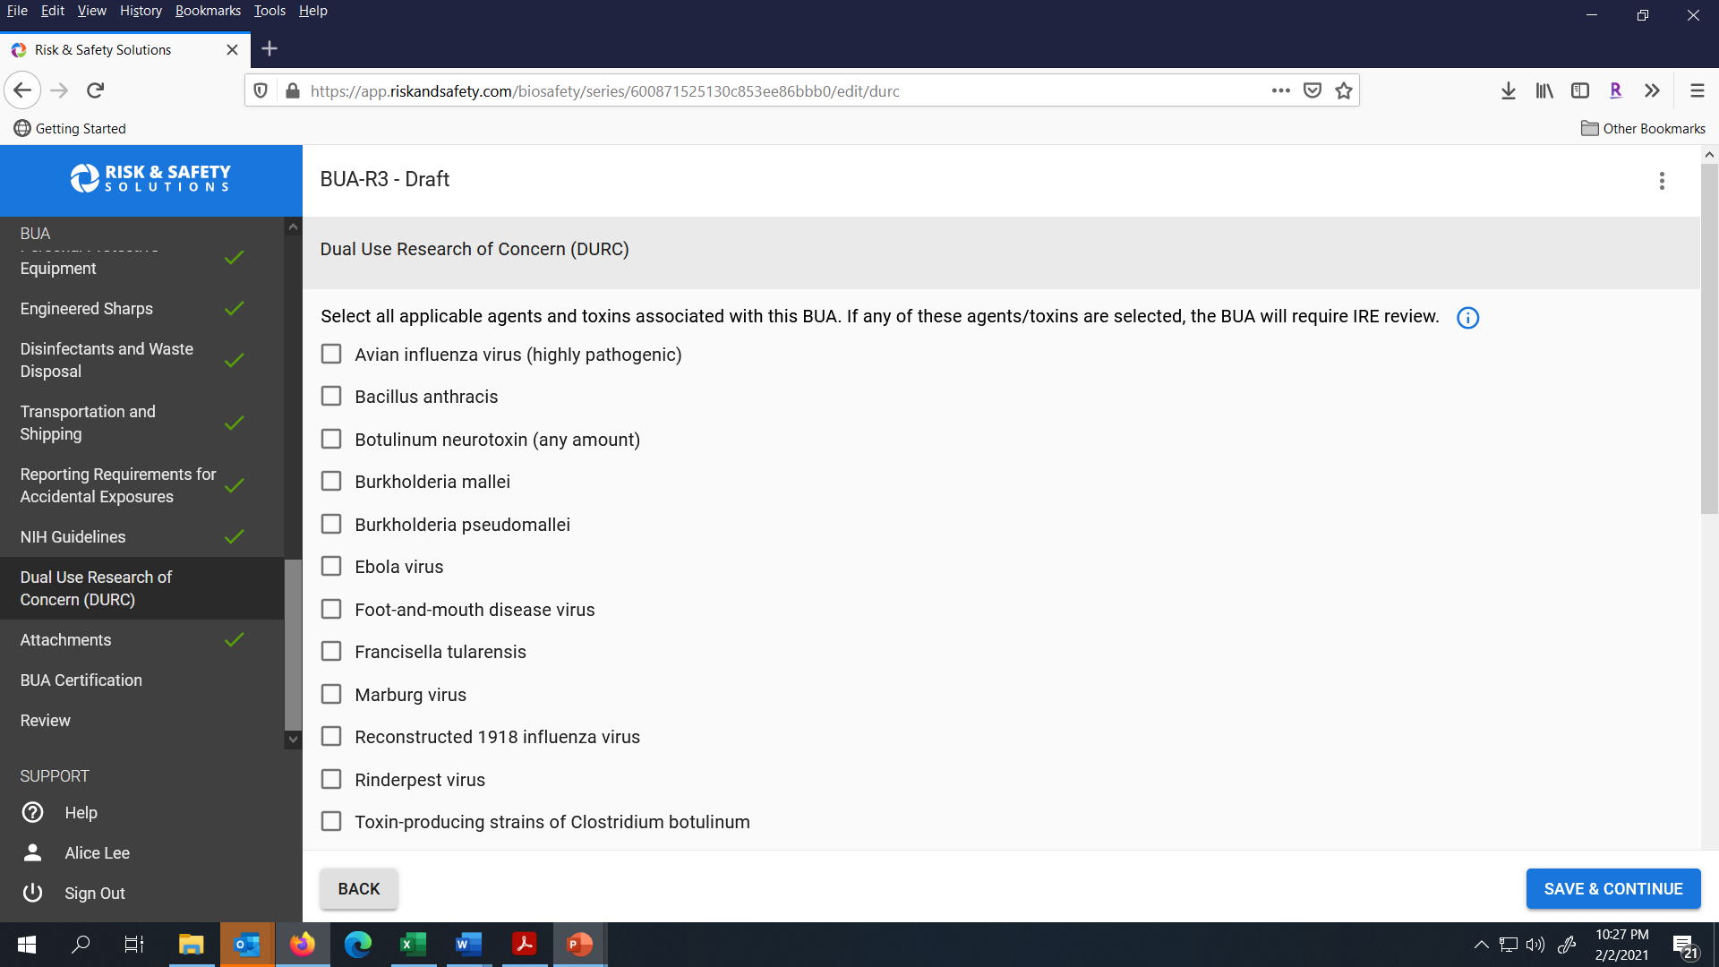
Review the Dual Use Research of Concern section and then click Save & Continue to go to the next section.

Slide 31

Upload any additional documents needed for the new work being done by your lab. Click Save & Continue to go to the next section.

Slide 32
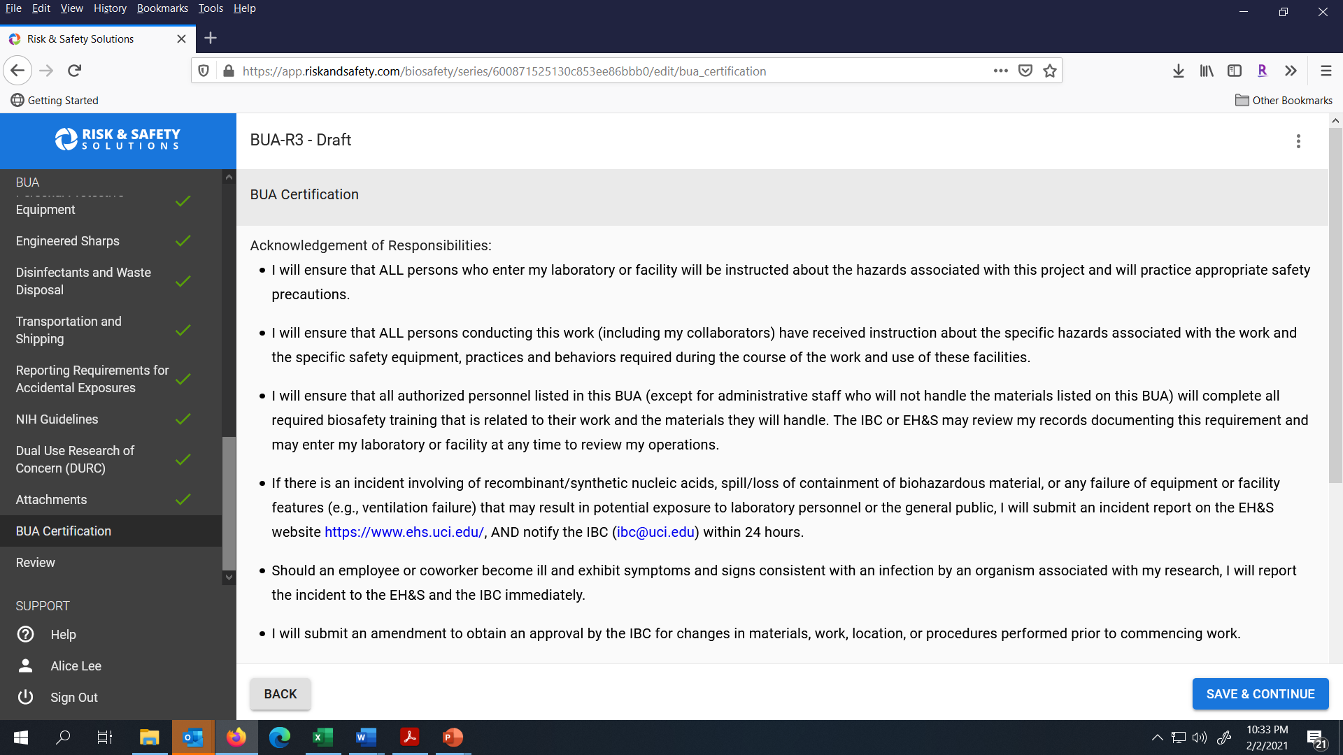
Review the certification for your BUA. Click Save & Continue to go to the next section.

Slide 33
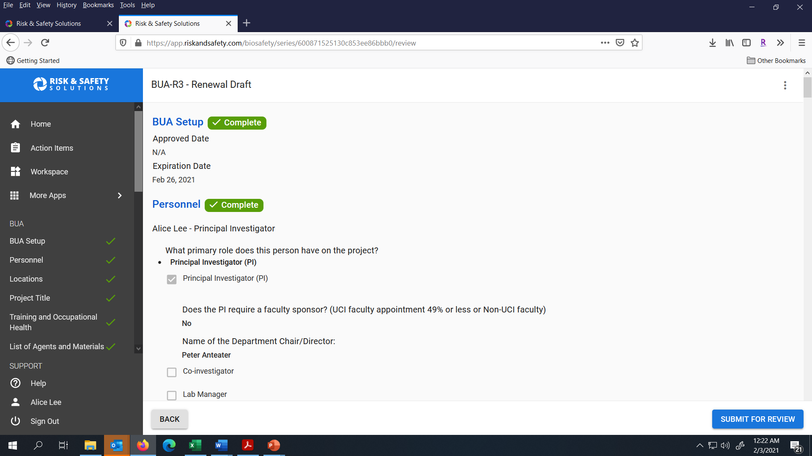
Review the summary of your BUA and use the left navigation menu to access specific sections. Click Submit for Review when you are ready to submit the Amendment to your BUA to the IBC Administrator.

Slide 34
Quick facts about the IBC BUA review process
The Institutional Biosafety Committee (IBC) meets the 3rd Wednesday of each month to review BUA’s for the work being performed on campus.
A Biosafety Inspection (BI) of your study locations may be done in conjunction with the IBC’s review. Biosafety will contact you or your designee to schedule the BI.
Questions? Please contact ibc@uci.edu.

